Slide 1
Structural Damage Assessment
July 2020

Slide 2
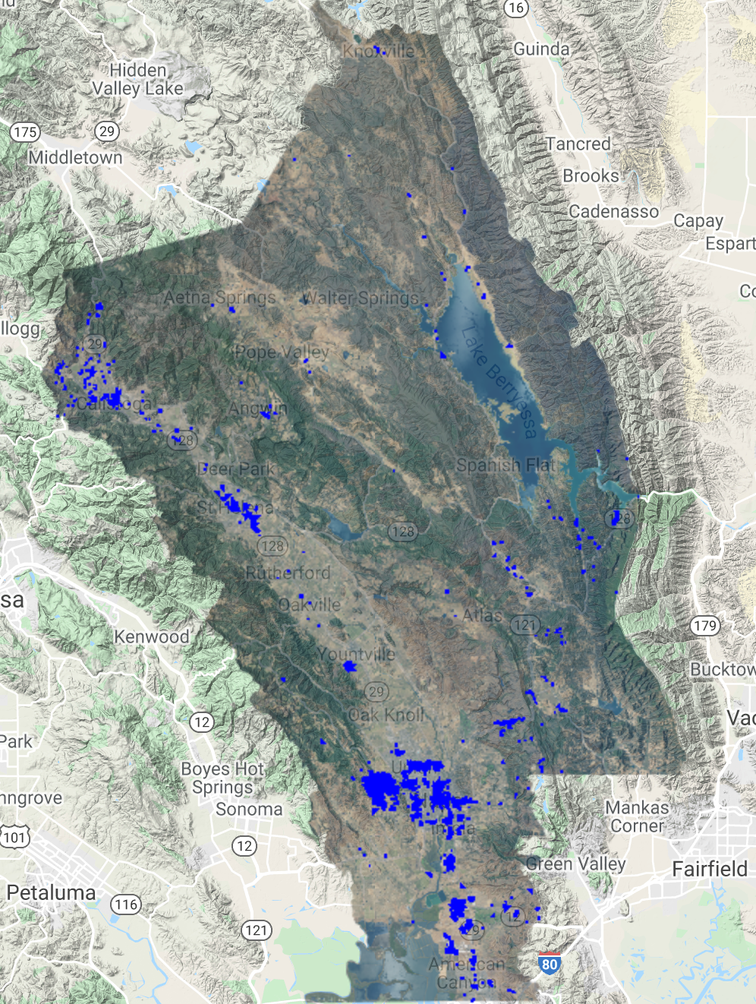
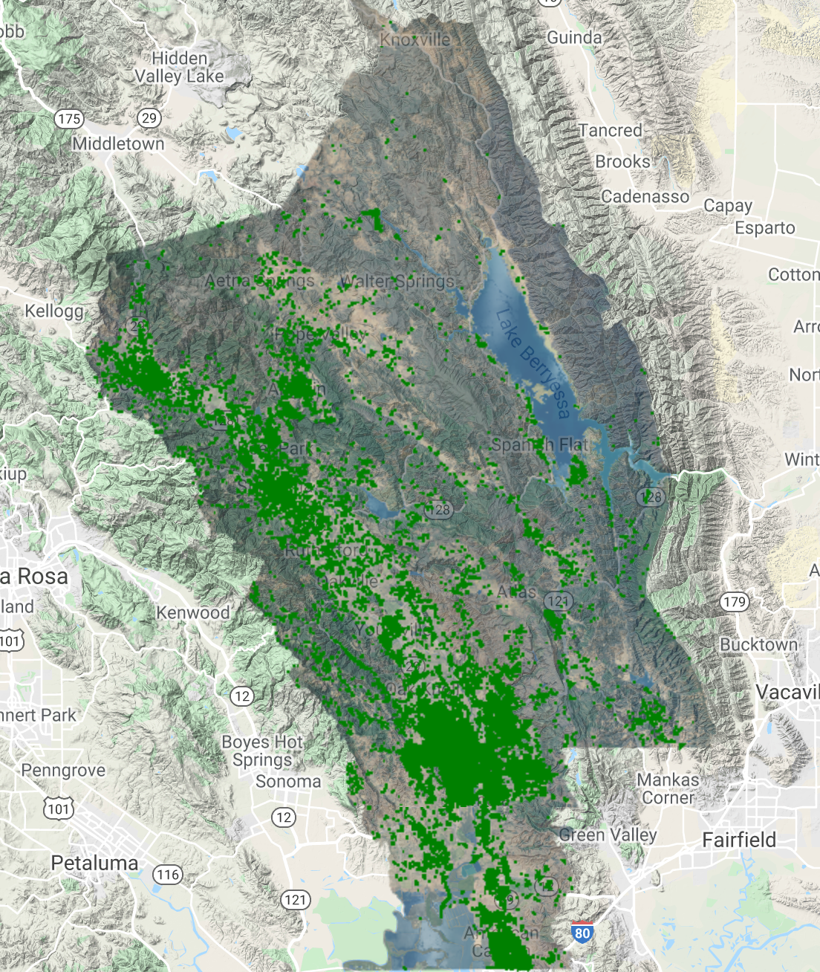
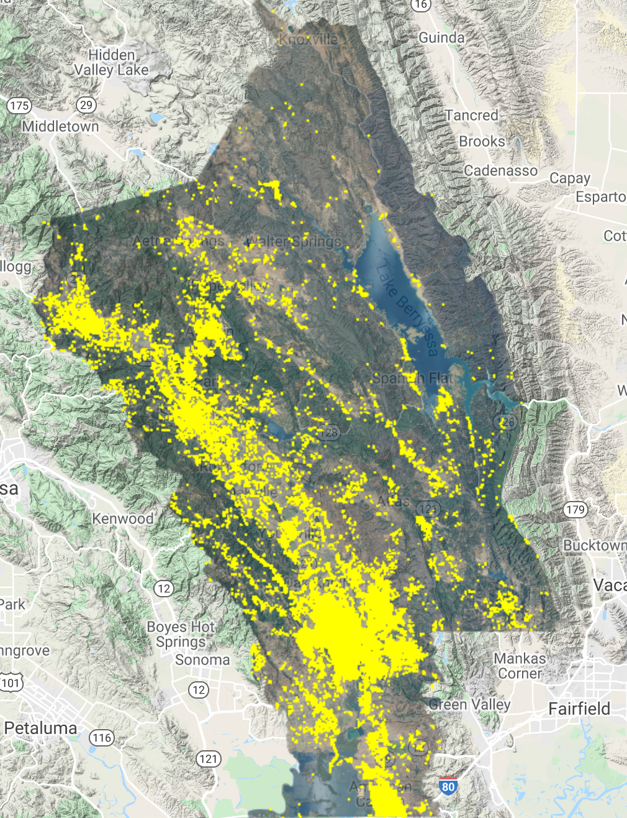
Case 1: Napa County
Open Street Map
Microsoft
County Level

Slide 3
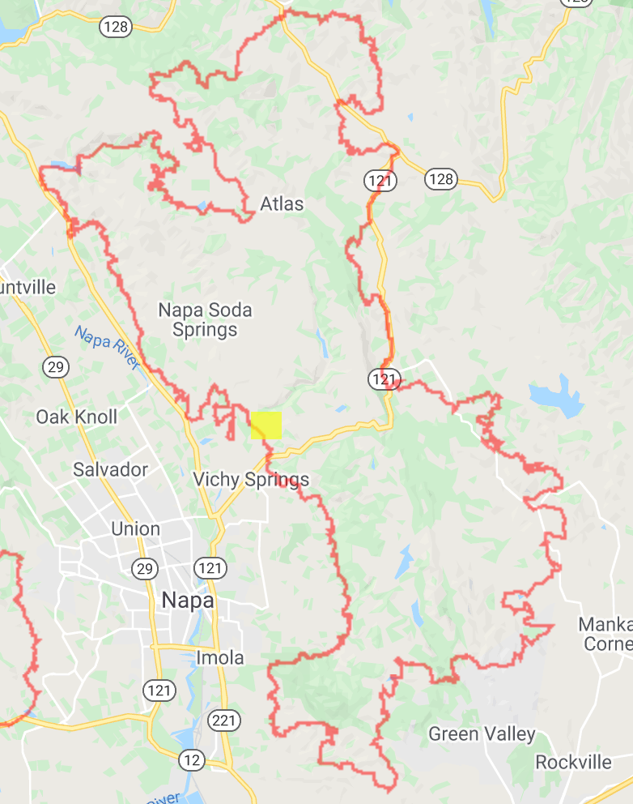
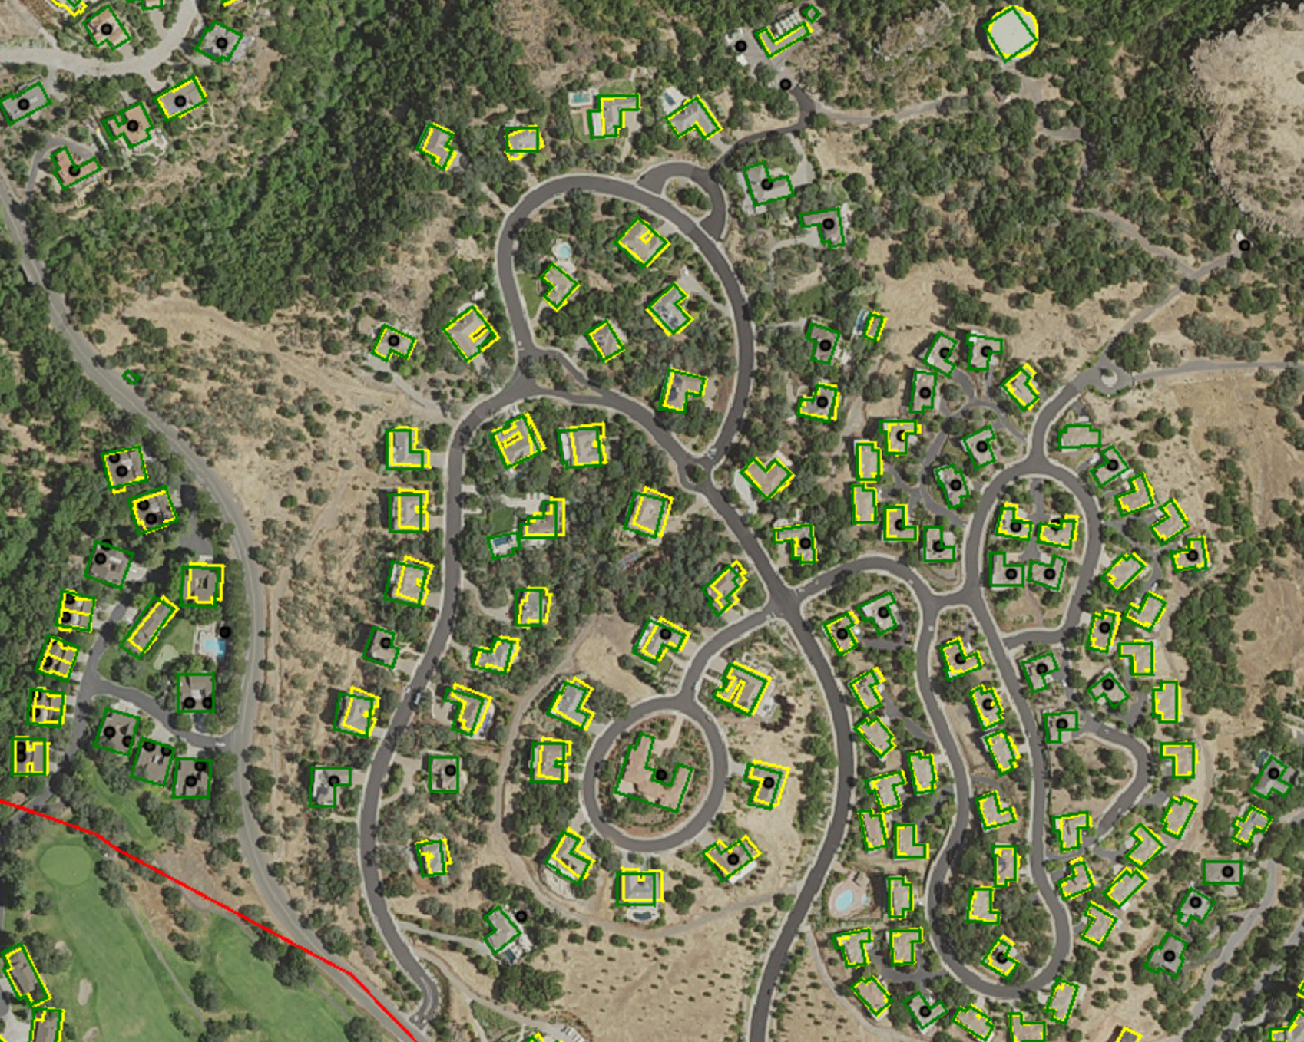
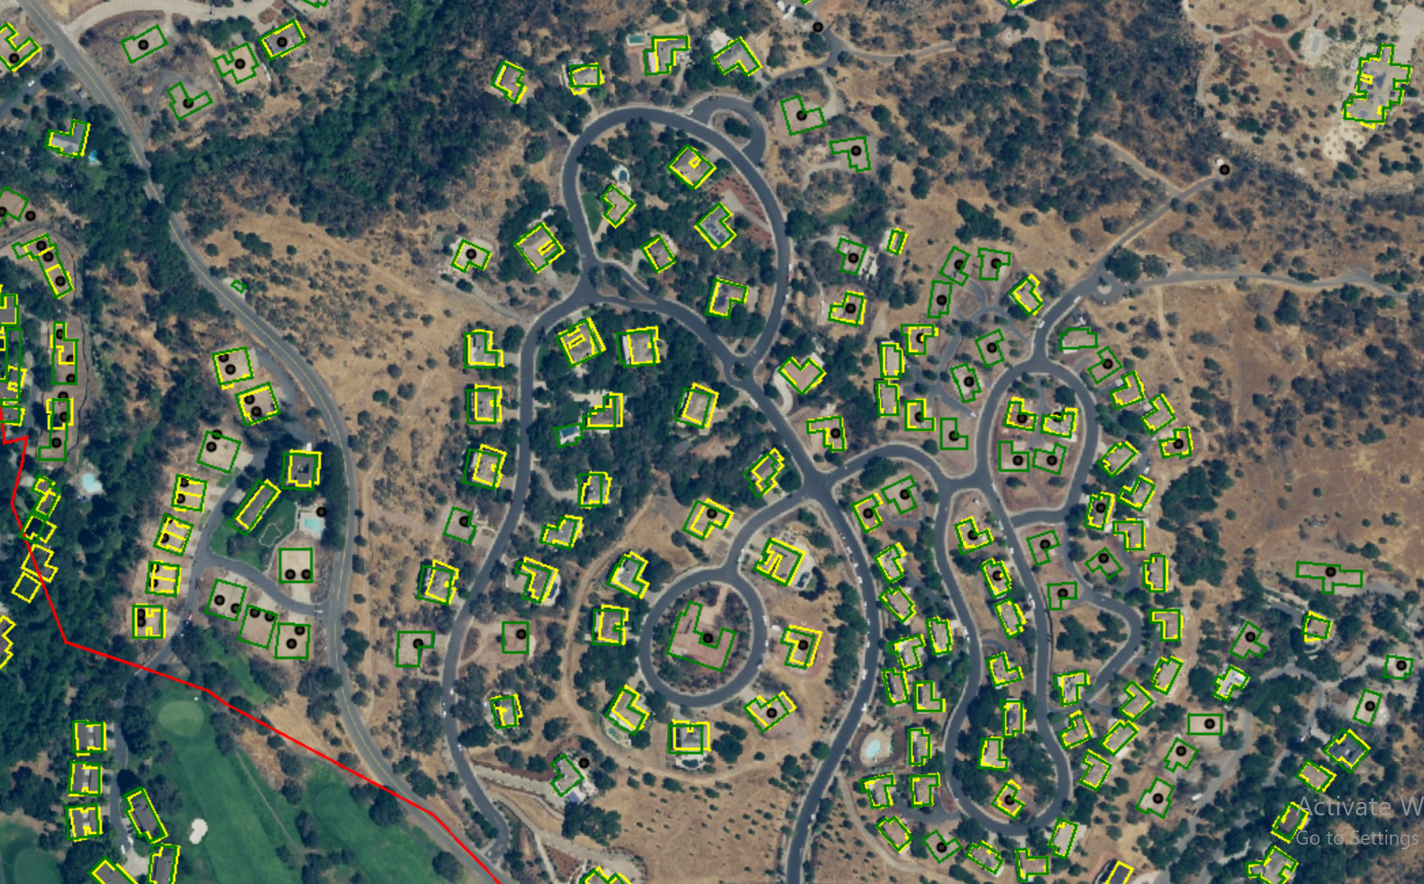
Case 1.1: Napa County
Pre Fire (NAIP)
Post Fire (NAIP)
Microsoft
County Source
OSM
Damaged
Fire Perimeter

Slide 4
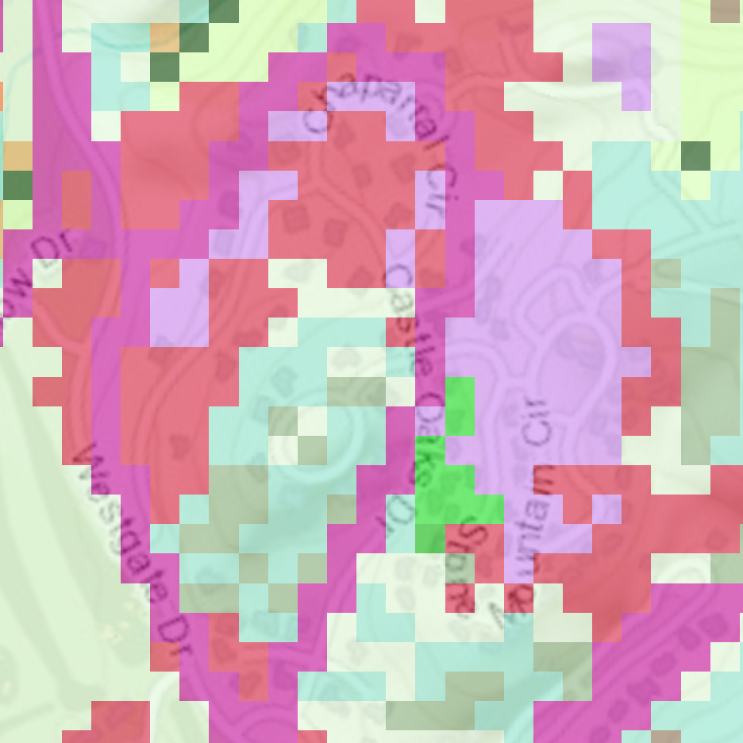
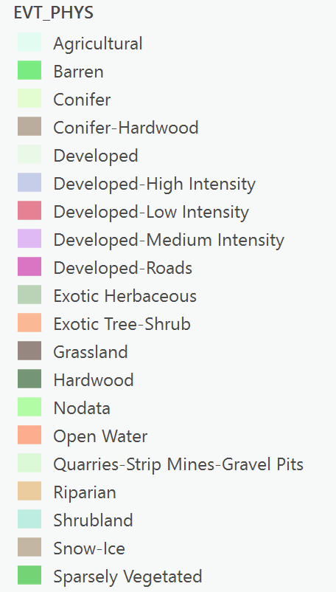
Case 1.1: Napa County
Landfire Fuel Type (2014)

Slide 5
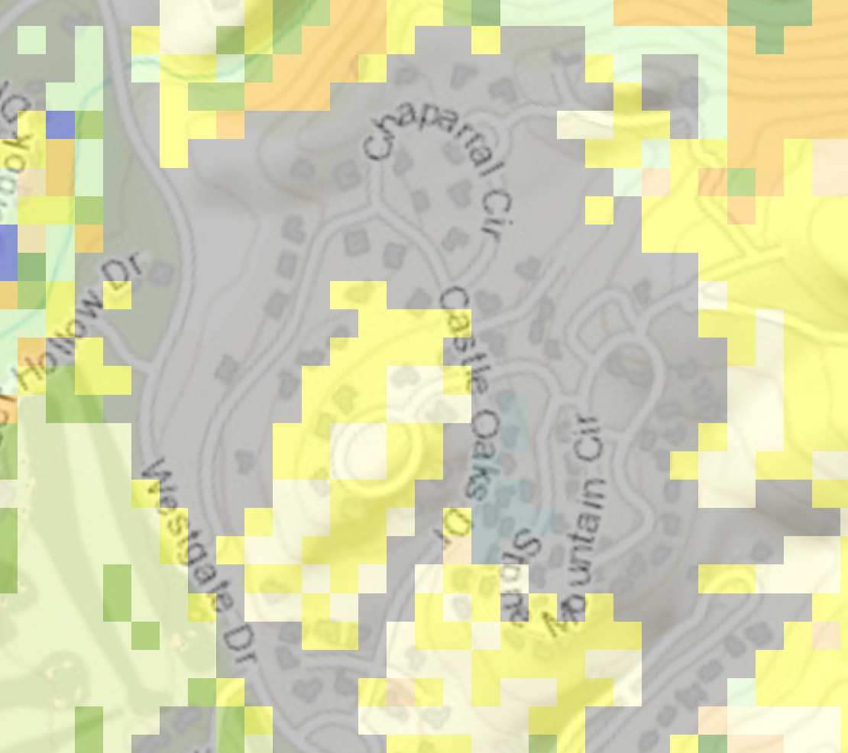
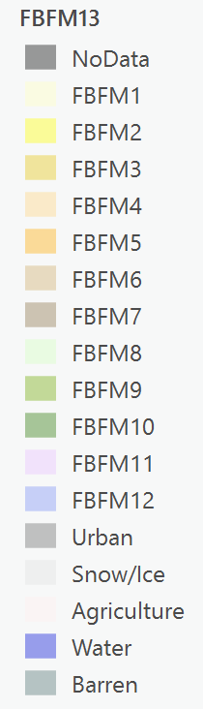
Case 1.1: Napa County
Anderson Fuel Model (2014)

Slide 6
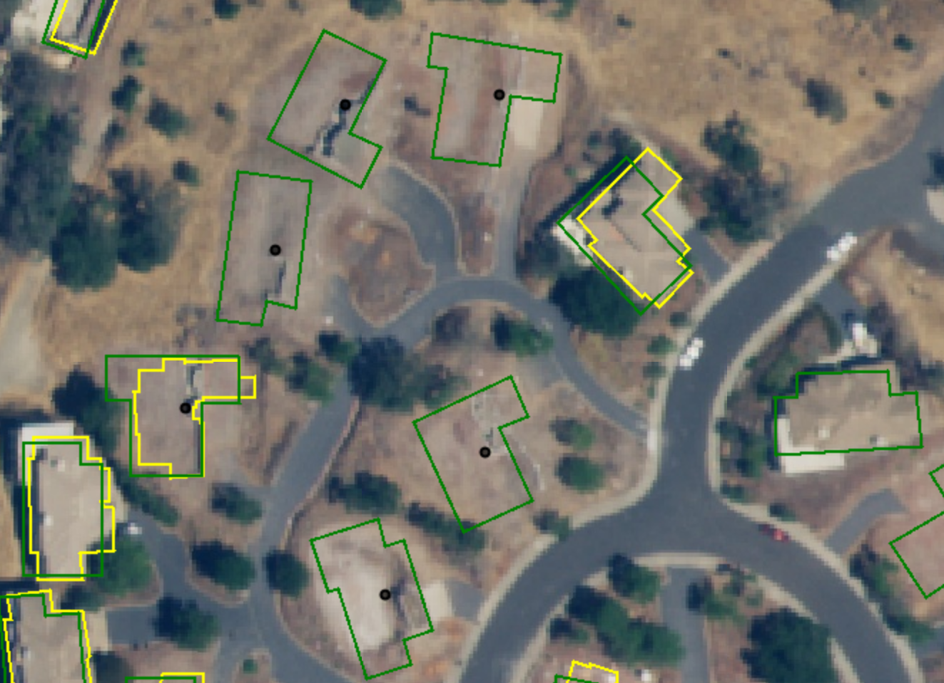
Case 1.1: Napa County
Post Fire (NAIP)
Microsoft
County Source
OSM
Damaged
Fire Perimeter

Slide 7
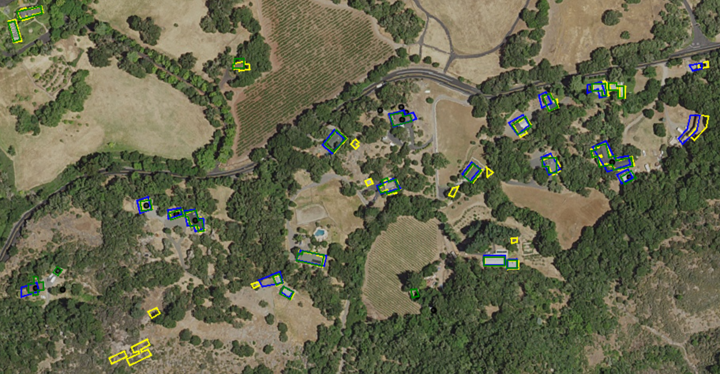
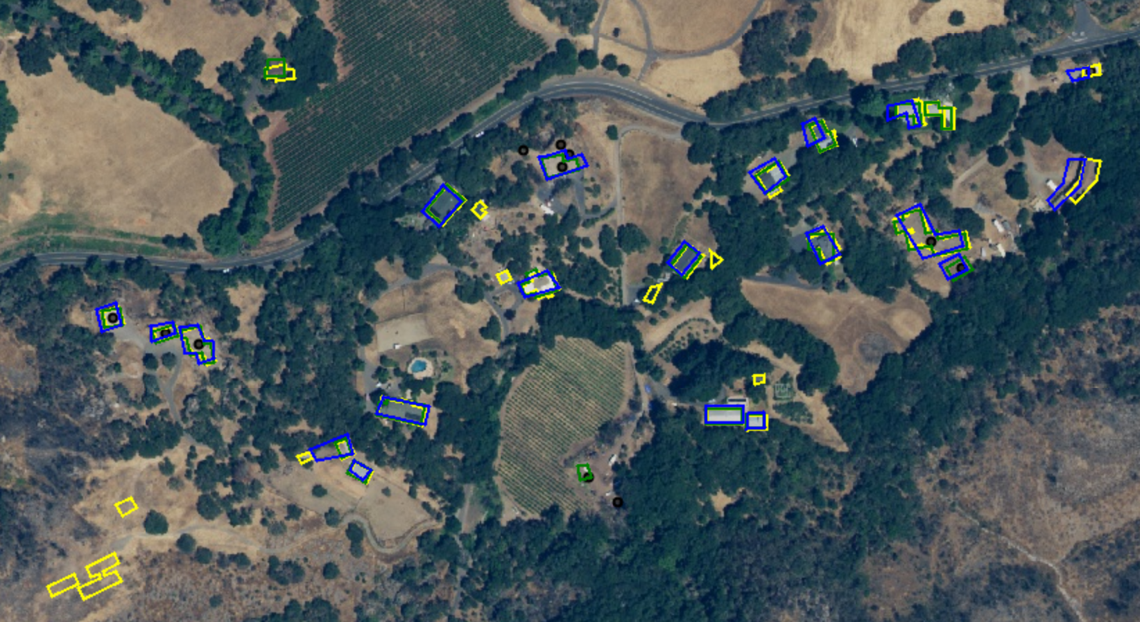
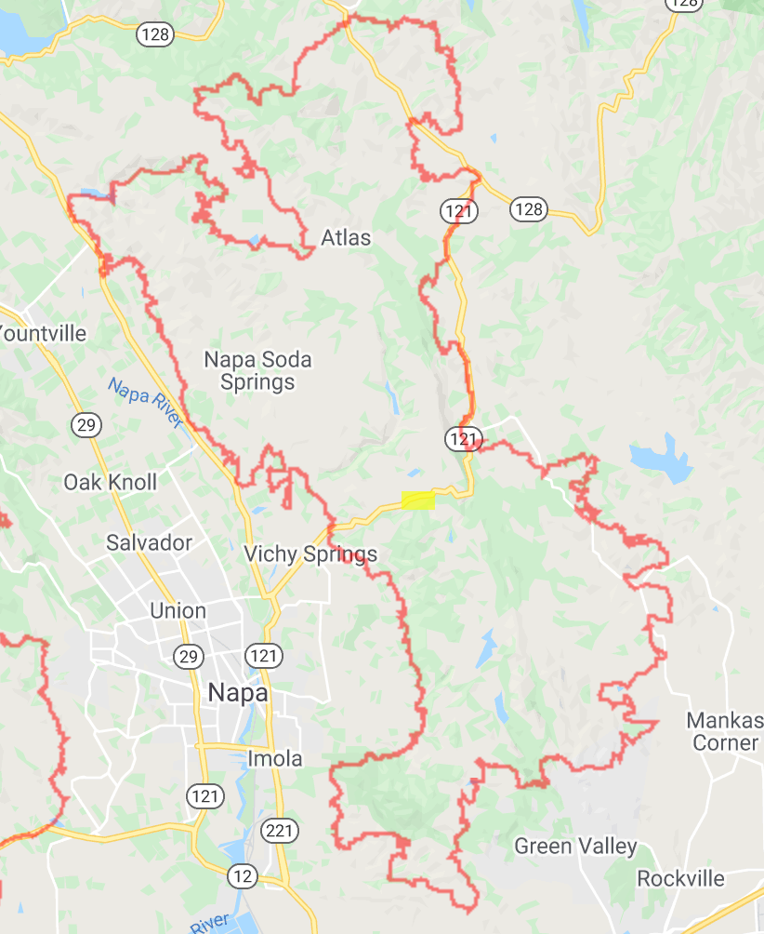
Case 1.2: Napa County
Pre Fire (NAIP)
Post Fire (NAIP)
Microsoft
County Source
OSM
Damaged
Fire Perimeter

Slide 8
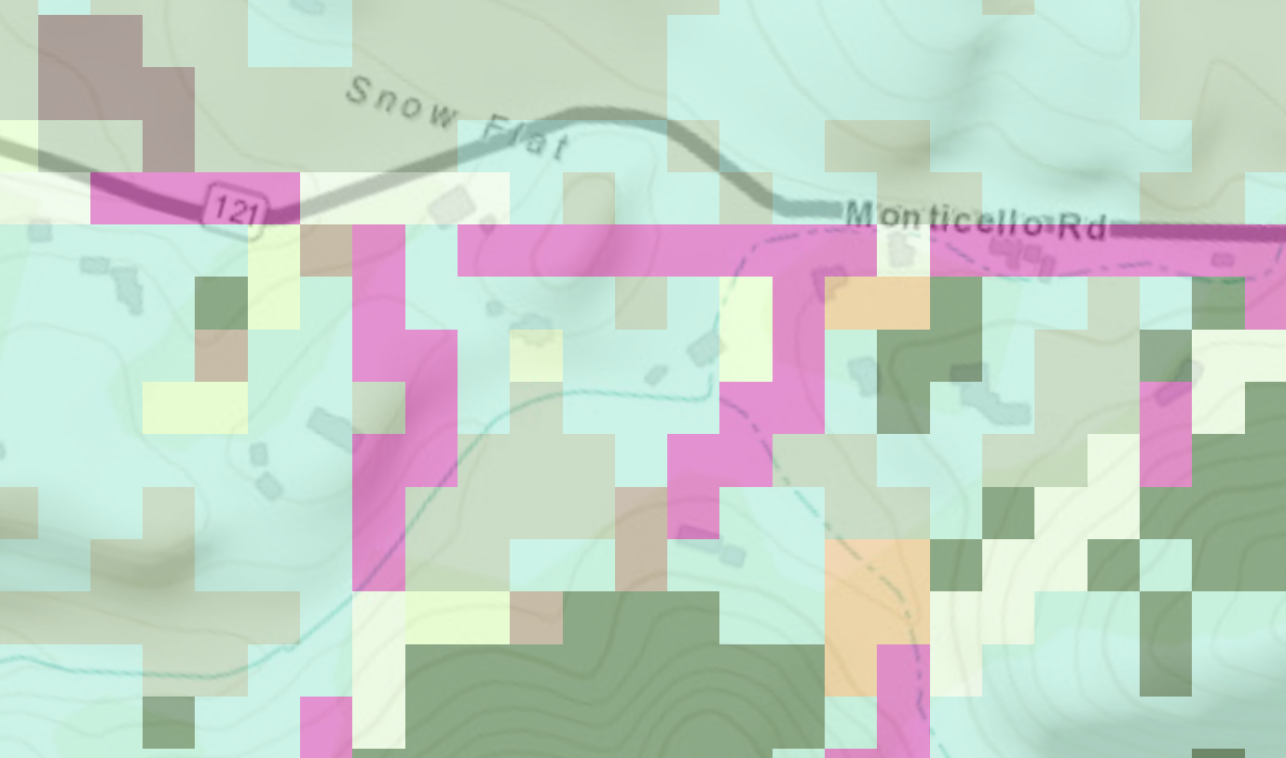
Case 1.2: Napa County
Landfire Fuel Type (2014)

Slide 9
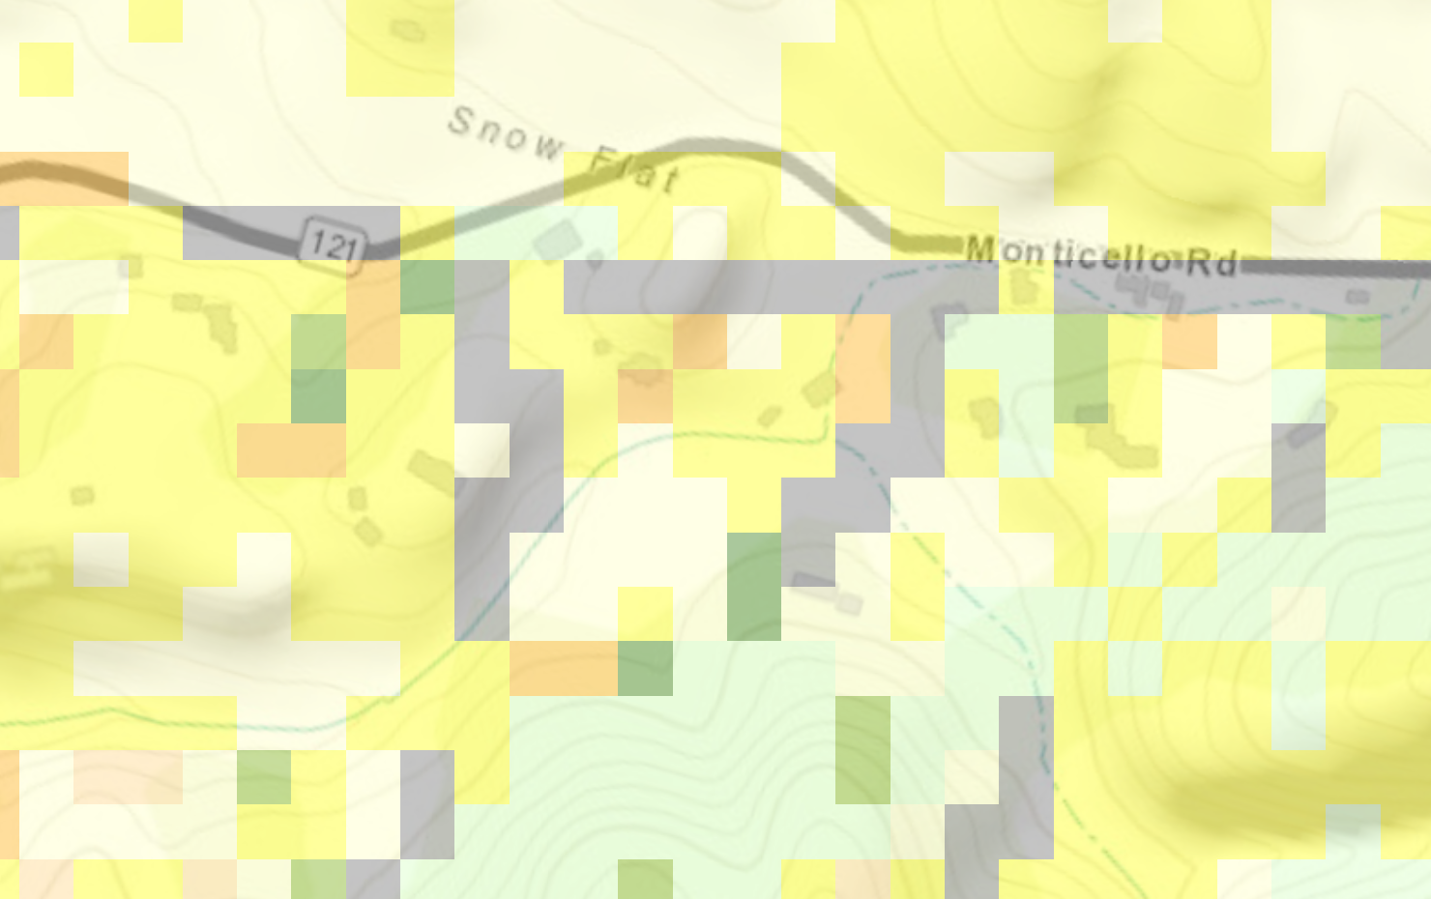
Case 1.2: Napa County
Anderson Fuel Model (2014)

Slide 10
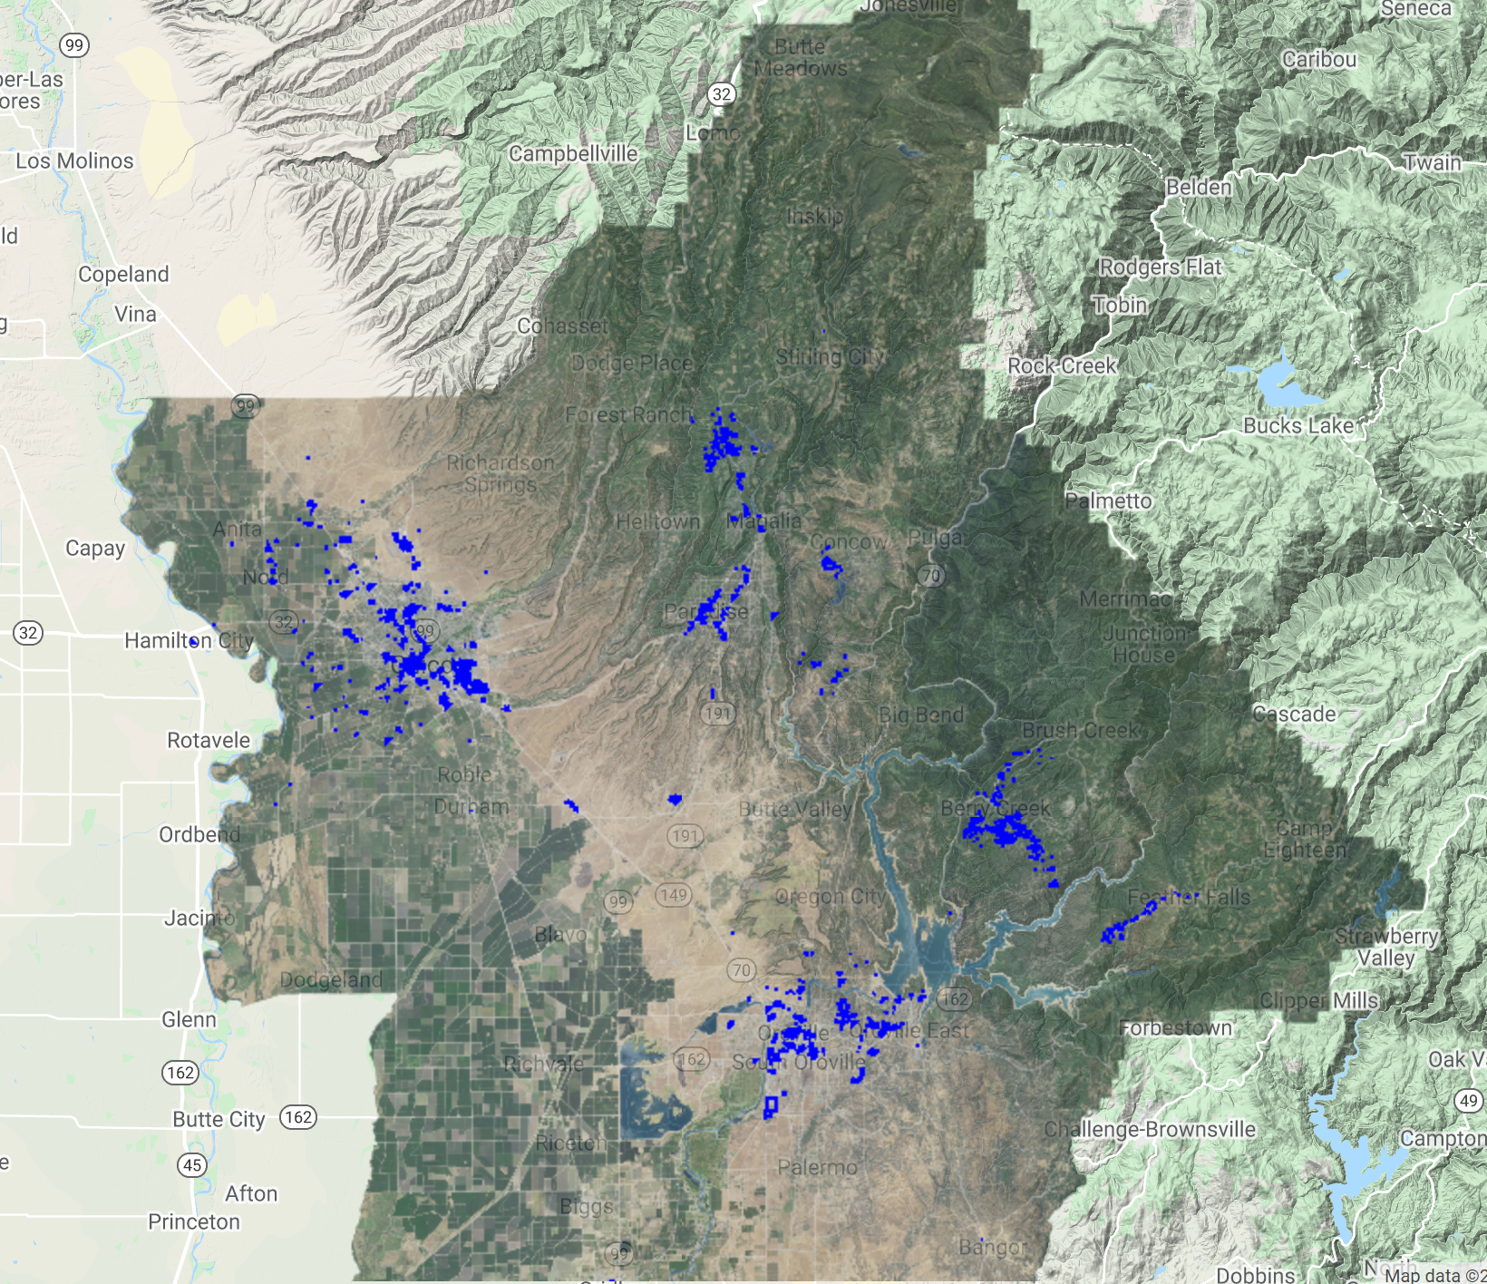
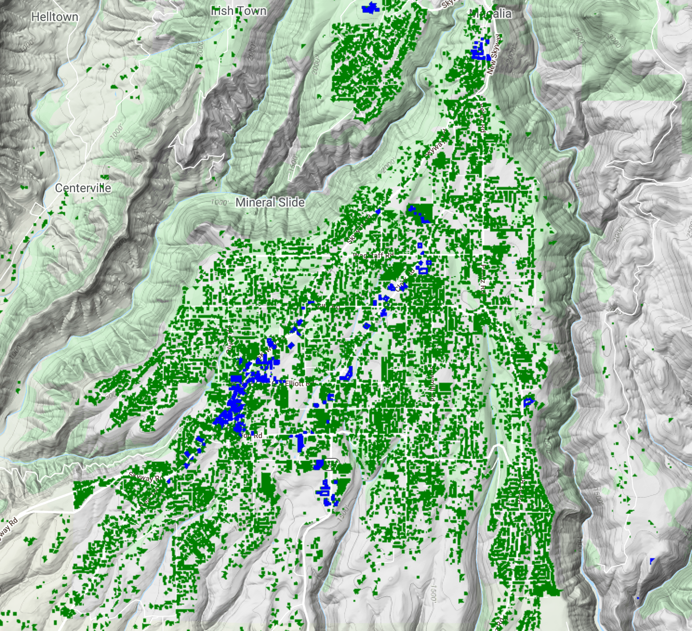
Case 2: Paradise
Open Street Map
Microsoft

Slide 11
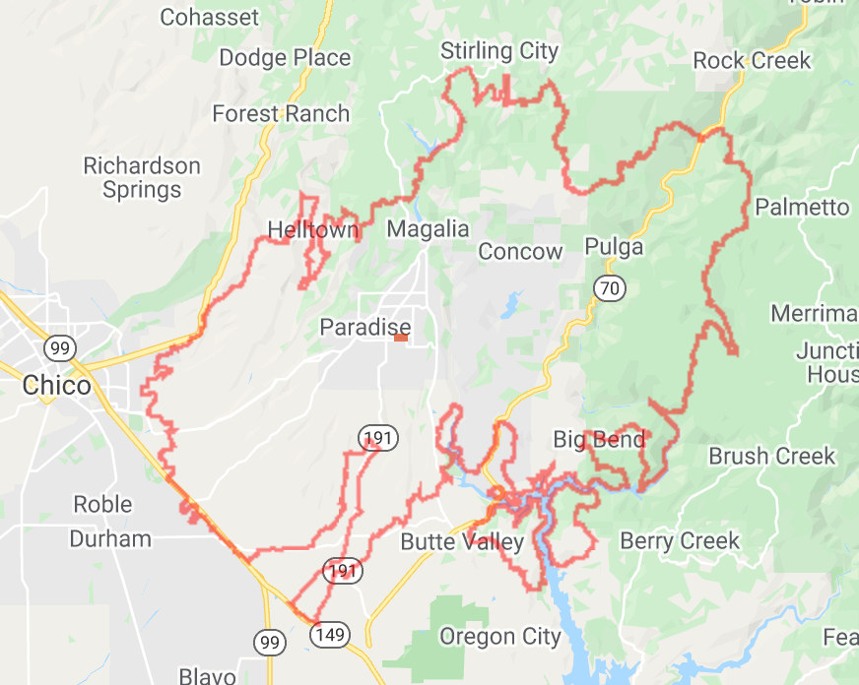
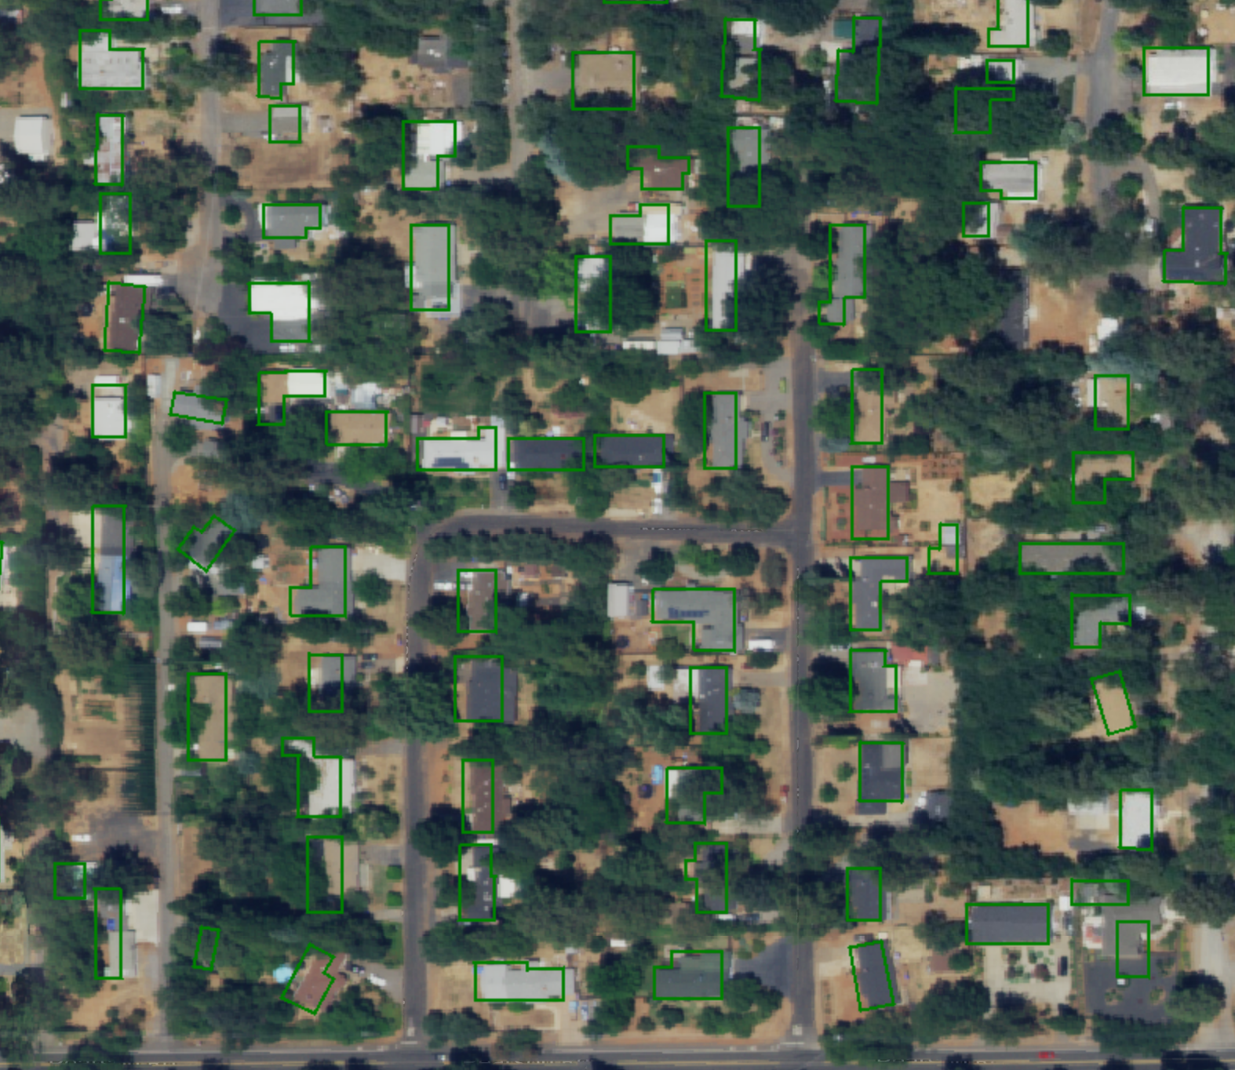
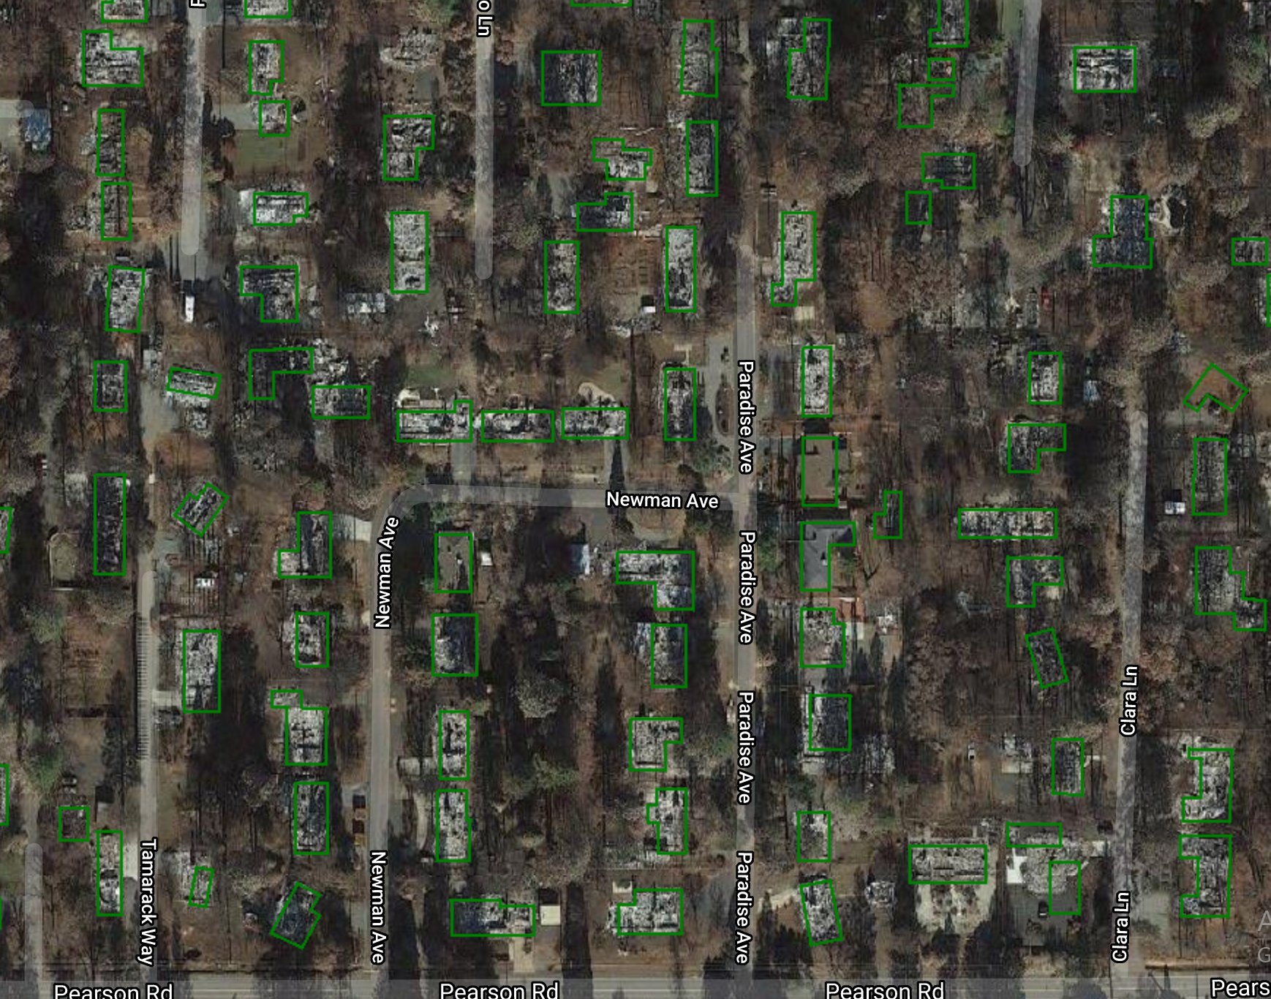
Case 2.1: Paradise
Pre Fire (NAIP)
Post Fire (Basemap)
Microsoft
OSM
Damaged
Fire Perimeter

Slide 12
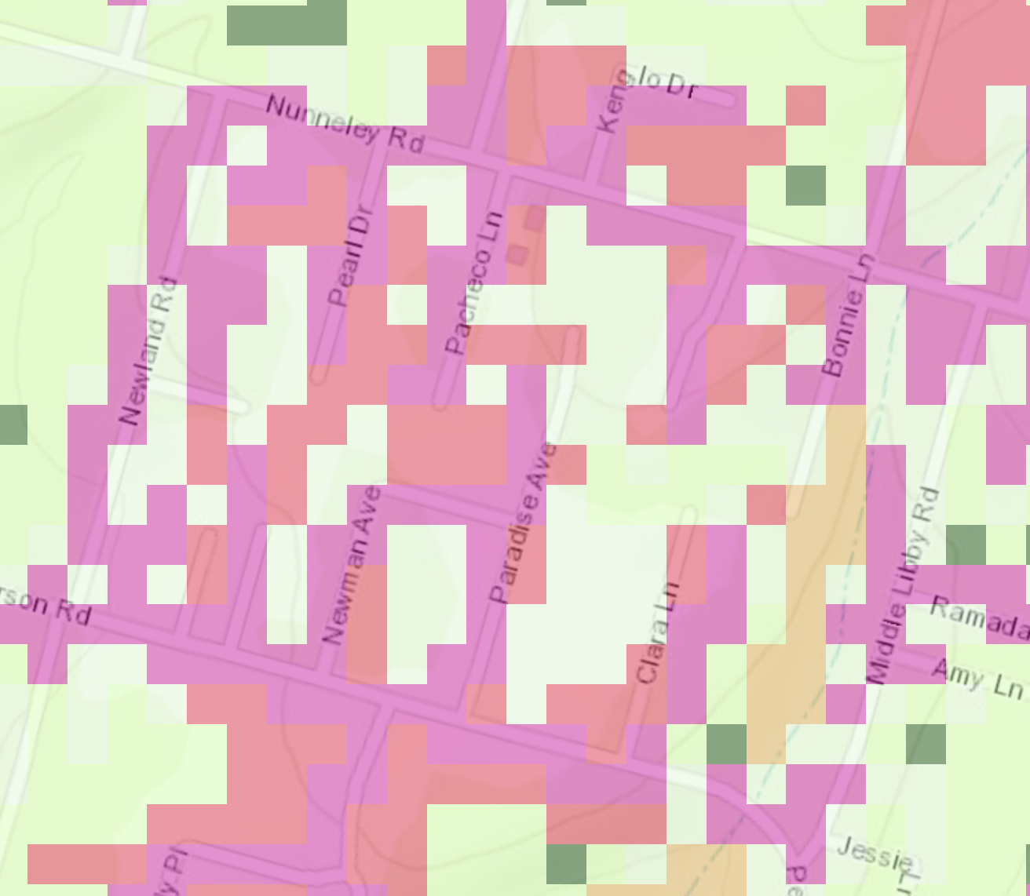
Case 2.1: Paradise
Landfire Fuel Type (2014)

Slide 13
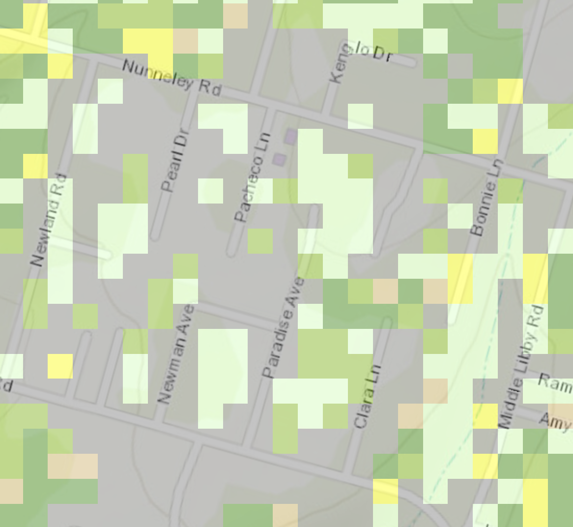
Case 2.1: Paradise
Anderson Fuel Model (2014

Slide 14
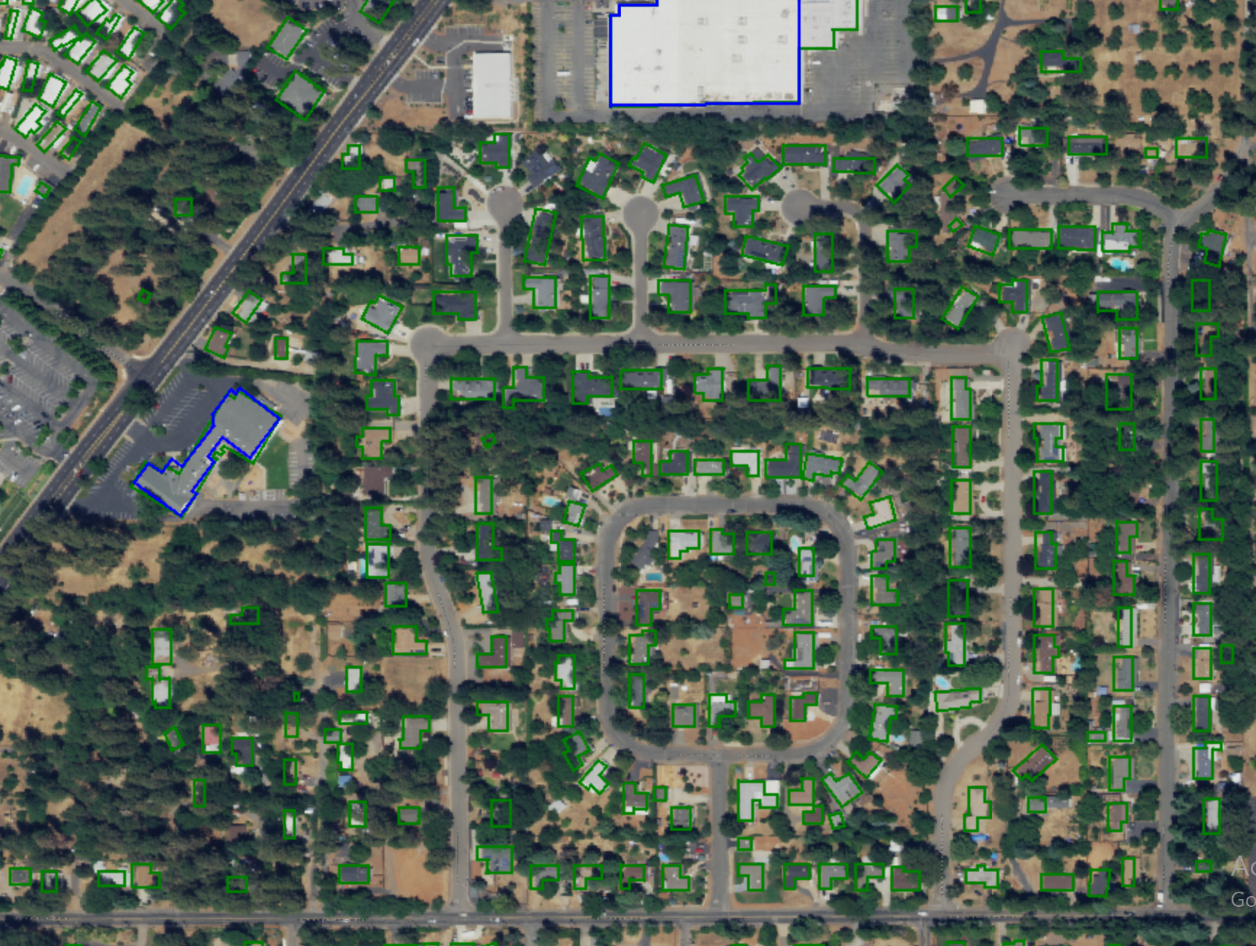
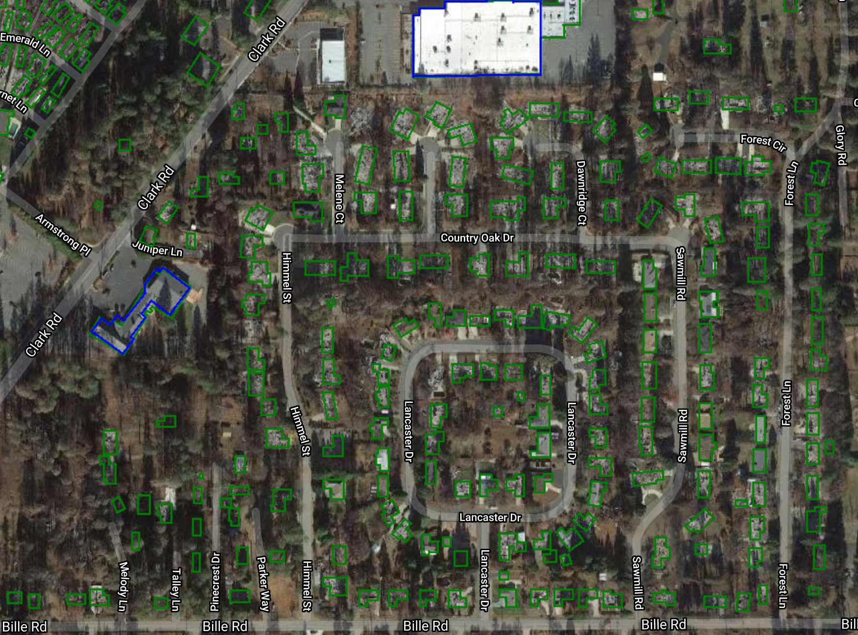
Case 2.1: Paradise
Pre Fire (NAIP)
Post Fire (Basemap)
Microsoft
OSM
Damaged
Fire Perimeter

Slide 15
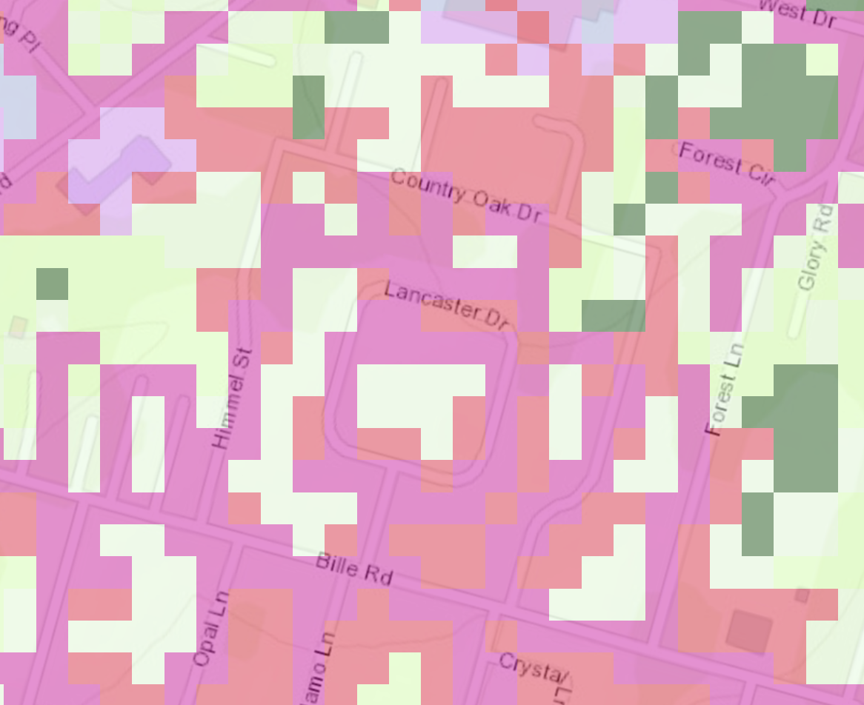
Case 2.1: Paradise
Landfire Fuel Type(2014)

Slide 16
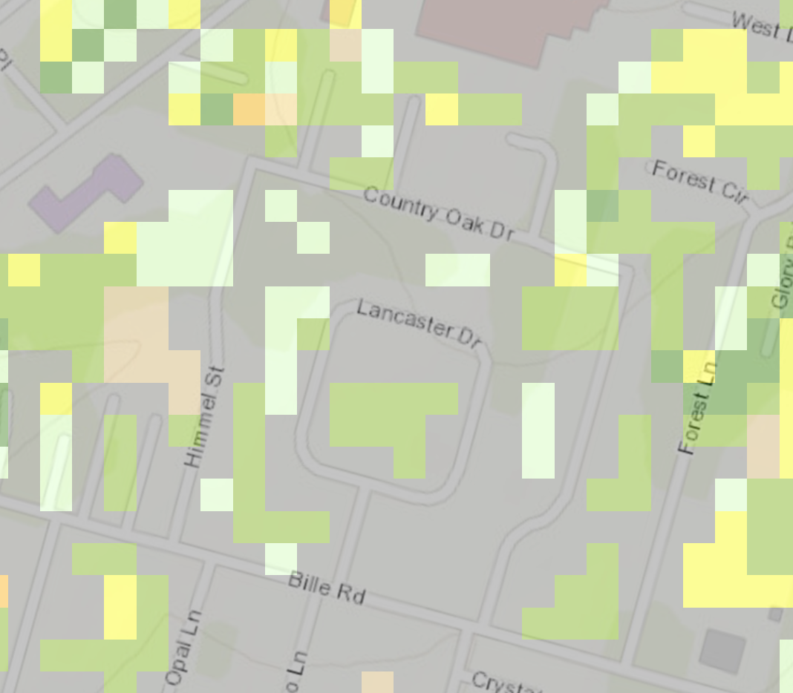
Case 2.1: Paradise
Anderson Fuel Model (2014)

Slide 17
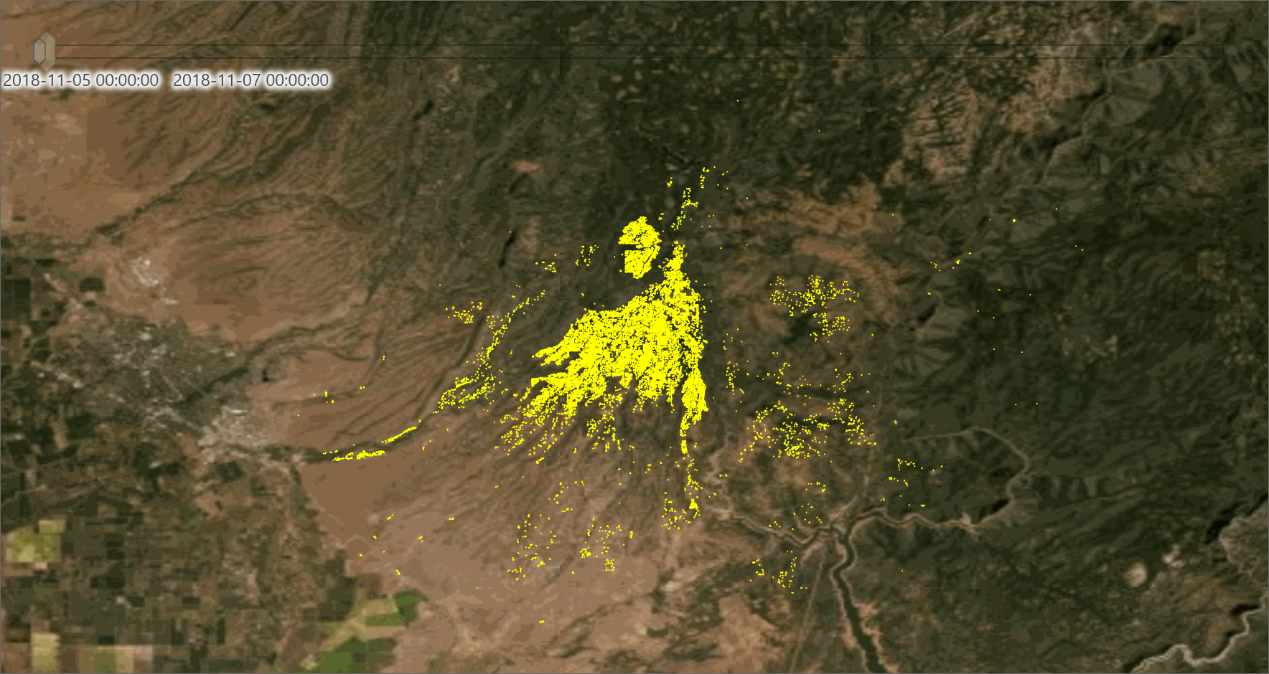
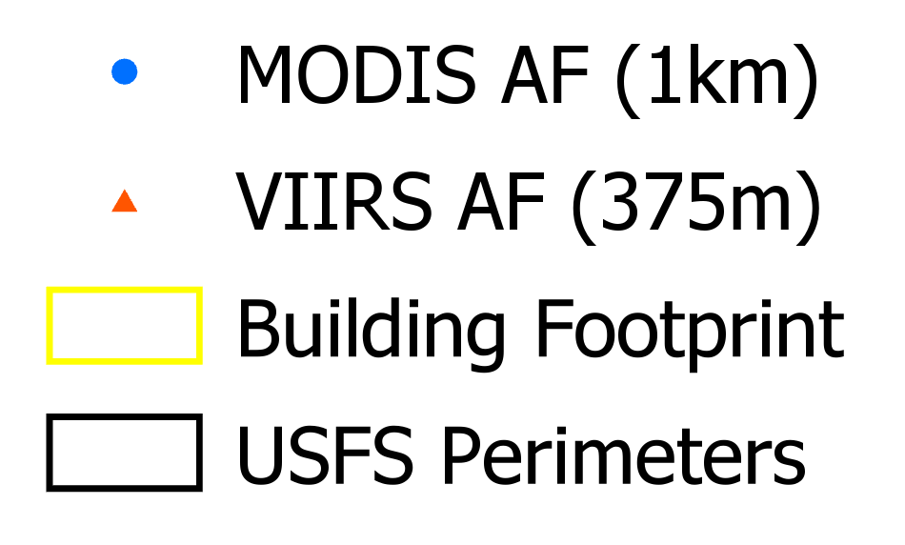

Slide 18
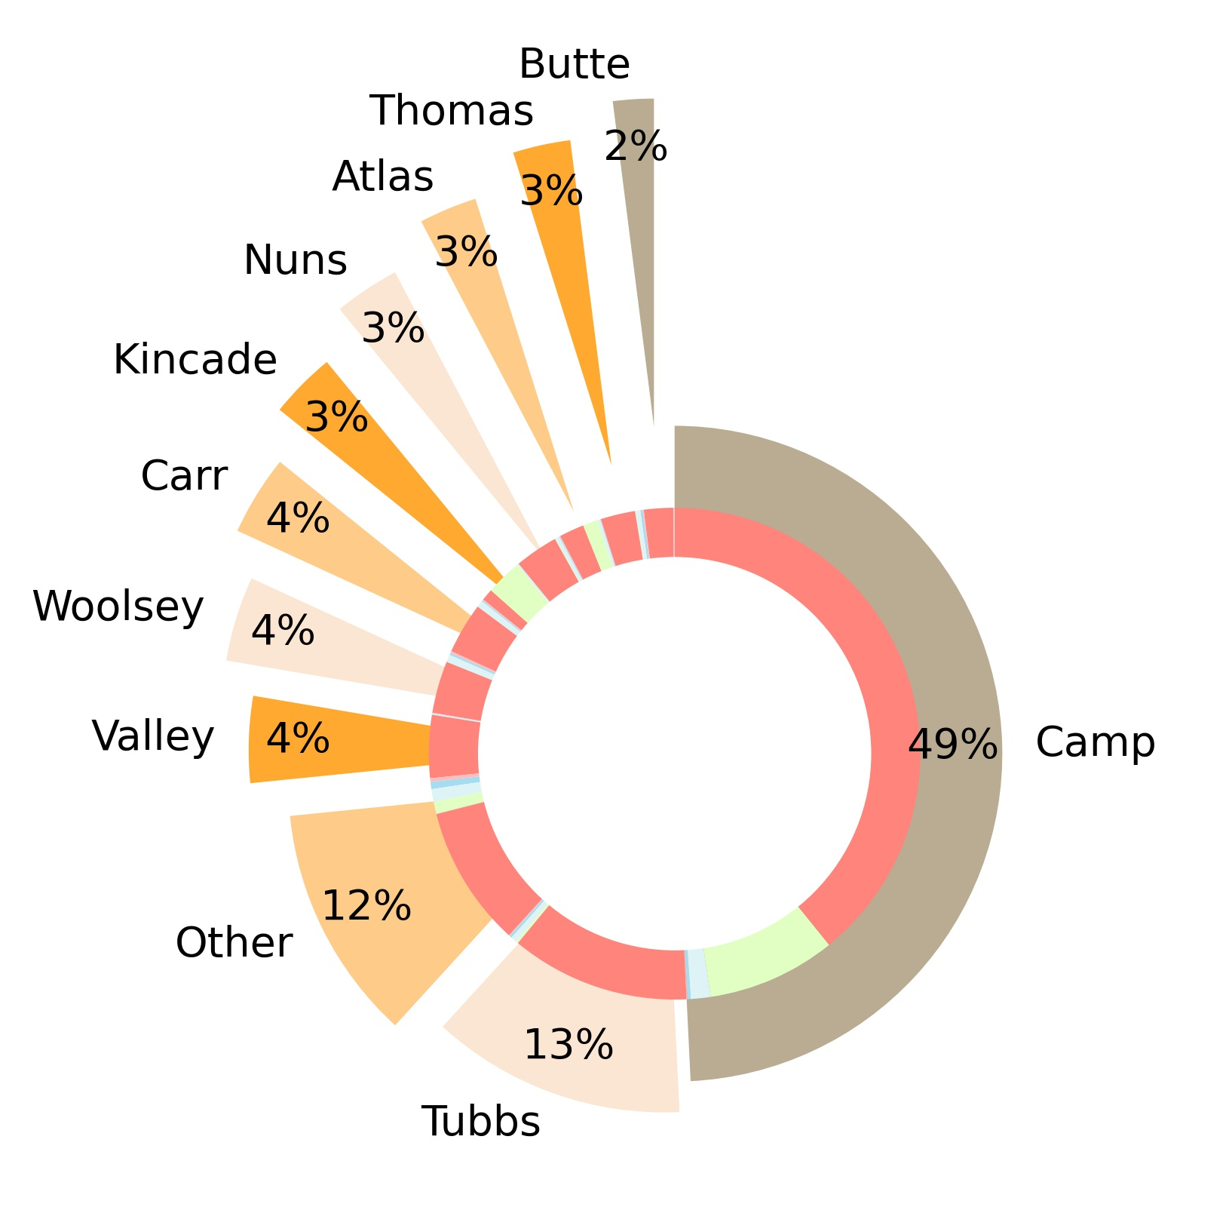
Structural Damage Dataset
Incident Name | Affected (1-9%) | Destroyed (>50%) | Major (26-50%) | Minor (10-25%) | No Damage
Atlas | 85 | 787 | 10 | 21 | 469
Butte | 25 | 928 | 5 | 6 | NaN
Camp | 626 | 18804 | 27 | 101 | 4066
Carr | 212 | 1611 | 28 | 39 | NaN
Kincade | 40 | 374 | 6 | 14 | 1134
Nuns | 117 | 1367 | 15 | 28 | 27
Thomas | 146 | 1091 | 39 | 70 | 19
Tubbs | 186 | 5656 | 32 | 75 | 74
Valley | 31 | 1985 | 13 | 17 | NaN
Woolsey | 236 | 1643 | 62 | 66 | NaN
Destroyed (>50%)
Damage Type | Count
Major (26-50%) | 351
Minor (10-25%) | 662
Affected (1-9%) | 2103
No Damage | 6163
Destroyed (>50%) | 38696
Major (26-50%)
Minor (10-25%)
Affected (1-9%)
No Damage
Inaccessible
Total: 47975

Slide 19
Structural Damage Dataset
Damage Classes: 6 ['Destroyed (>50%)', 'Affected (1-9%)', 'Major (26-50%)', 'Minor (10-25%)', 'No Damage', 'Inaccessible']
Fire Incidences: 110 ['Camp', 'Woolsey', 'Hill', 'Stoll', 'Pawnee', 'Ranch', 'River', 'Klamathon', 'Cranston', 'Carr', 'Holy', 'Grant', 'Frazier', 'Creek', 'Horse', 'Hyatt', 'Waverly', 'Ruby', 'County', 'West', 'Ridge', 'Irish', 'Nicolaus', 'Colusa', 'Vista', 'Carder', 'Spring', 'Marsh', 'Steele', 'Omega', 'Wagner', 'Delta', 'Meyers', 'Richmond', 'Holiday', 'Silver', 'Calgary', 'Ponderosa', 'Estate', 'Atlas', 'Nuns', 'Tubbs', 'Thomas', 'Pocket', 'Skirball', 'Bear', 'Cocos', 'Valley', 'Butte', 'Cascade', 'Clayton', 'Chimney', 'Sulphur', 'Black', 'Boles', 'Erskine', 'Soberanes', 'Tassajara', 'Round', 'Rocky', 'Stone', 'Alamo', 'Laverne', 'Whittier', 'Owens_River', 'Loma', 'Grade', 'Foothill', 'Thirty_Seven', 'Lilac', 'Mission', 'Peak', 'Detwiler', 'Redwood', 'Wall', 'Canyon_2', 'Cherokee', 'Laporte', 'McCourtney', 'Lobo', 'Spenceville', 'Pleasant', 'Helena', 'Goose', 'Railroad', 'Fay', 'Cathedral', 'Miller', 'Garza', 'Timm', 'Canyon', 'Clover', 'High', 'Sand', 'Trinity', 'Mines', 'Aborn', 'Pablo', 'Mountain', 'Willow', 'Rimrock', 'Swedes', 'Red_Bank', 'Sandalwood', 'Saddleridge', 'Forty_Six_46th', 'Maria', 'Getty', 'Kincade', 'Tick']
Structure Classes: 8 ['Single Residence', 'Other Minor Structure', 'Nonresidential Commercial', 'Multiple Residence', 'Mixed Commercial/Residential', 'Infrastructure', 'Agriculture', 'Other']
Structure Type: 19 ['Mobile Home Double Wide', 'Single Family Residence Single Story', 'Utility Misc Structure', 'Mobile Home Single Wide', 'Commercial Building Single Story', 'Multi Family Residence Single Story', 'Mobile Home Triple Wide', 'School', 'Single Family Residence Multi Story', 'Motor Home', 'Mixed Commercial/Residential', 'Commercial Building Multi Story', 'Church', 'Multi Family Residence Multi Story', 'Infrastructure', 'Agriculture', 'Single Family Residence Single Story', 'Hospital', 'Other']
Fire Date (unique count): 86

Slide 20
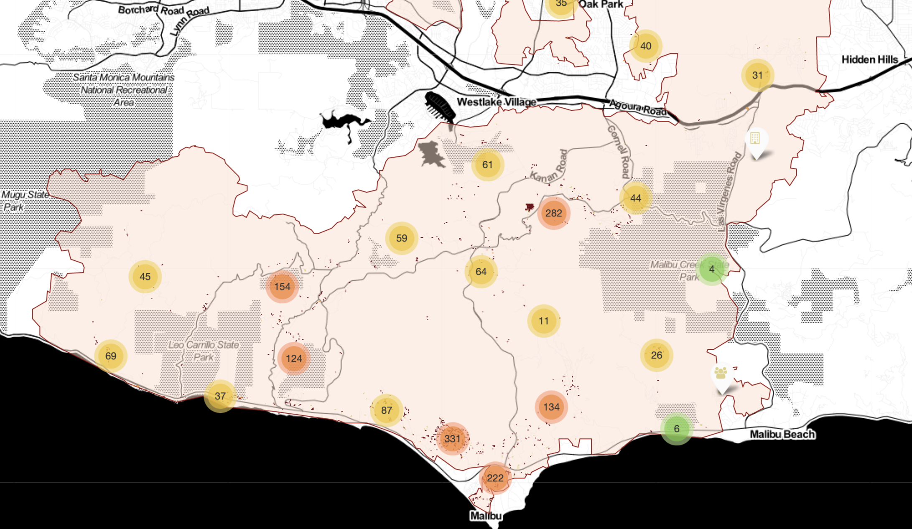
Woolsey Fire
Interactive Map

Slide 21
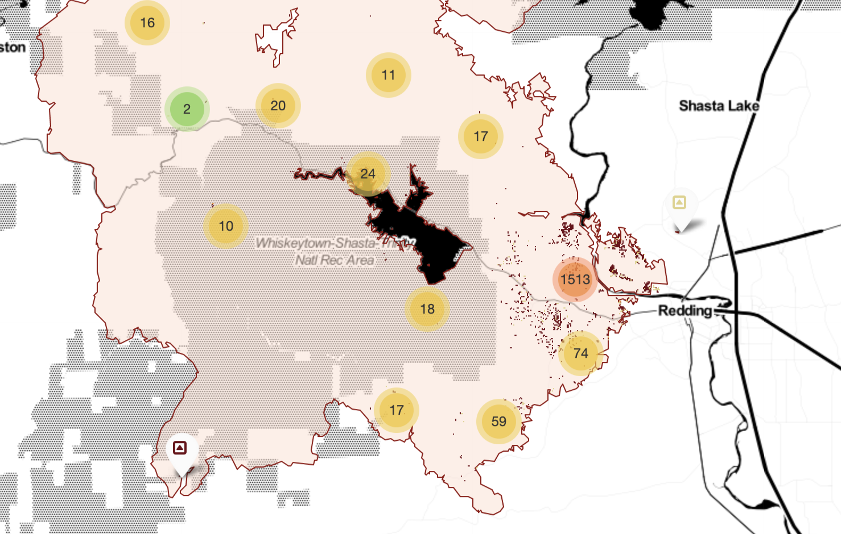
Carr Fire
Interactive Map

Slide 22
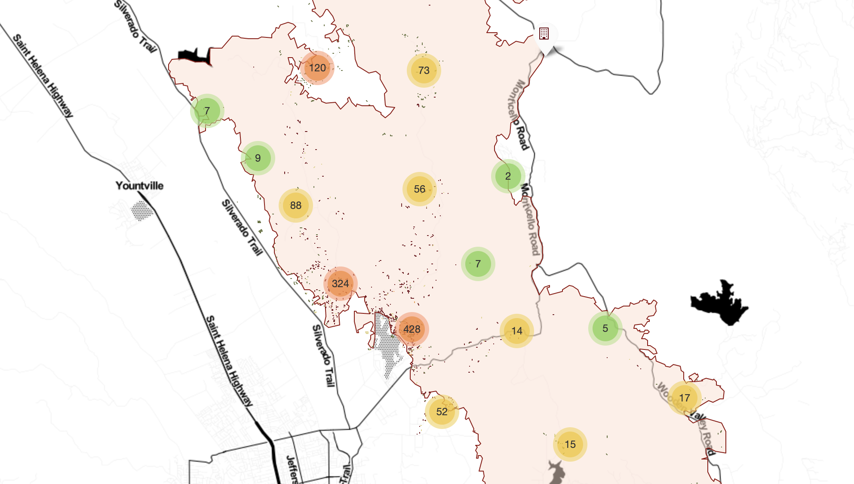
Atlas Fire
Interactive Map

Slide 23
Workflow
I. Pre-Disaster Footprint Extraction
II. Structural Damage Assessment
Building Footprint (Msft)
Building Footprints (Predicted)**
Damage Assessment Ground Survey
1
2
Bounding box (fire/year)
Spatial JOIN
3
Extract pre-fire NAIP Imagery
Extract post-fire NAIP Imagery
4
Building footprint Multi-channel* Image chips
Create RGB Tiles
5
Build Model
Build Model
* (1) Footprint, (2) Boundary, (3) Contact
** Based on model evaluation & NAIP availability ≤ 2017/18’

Slide 24
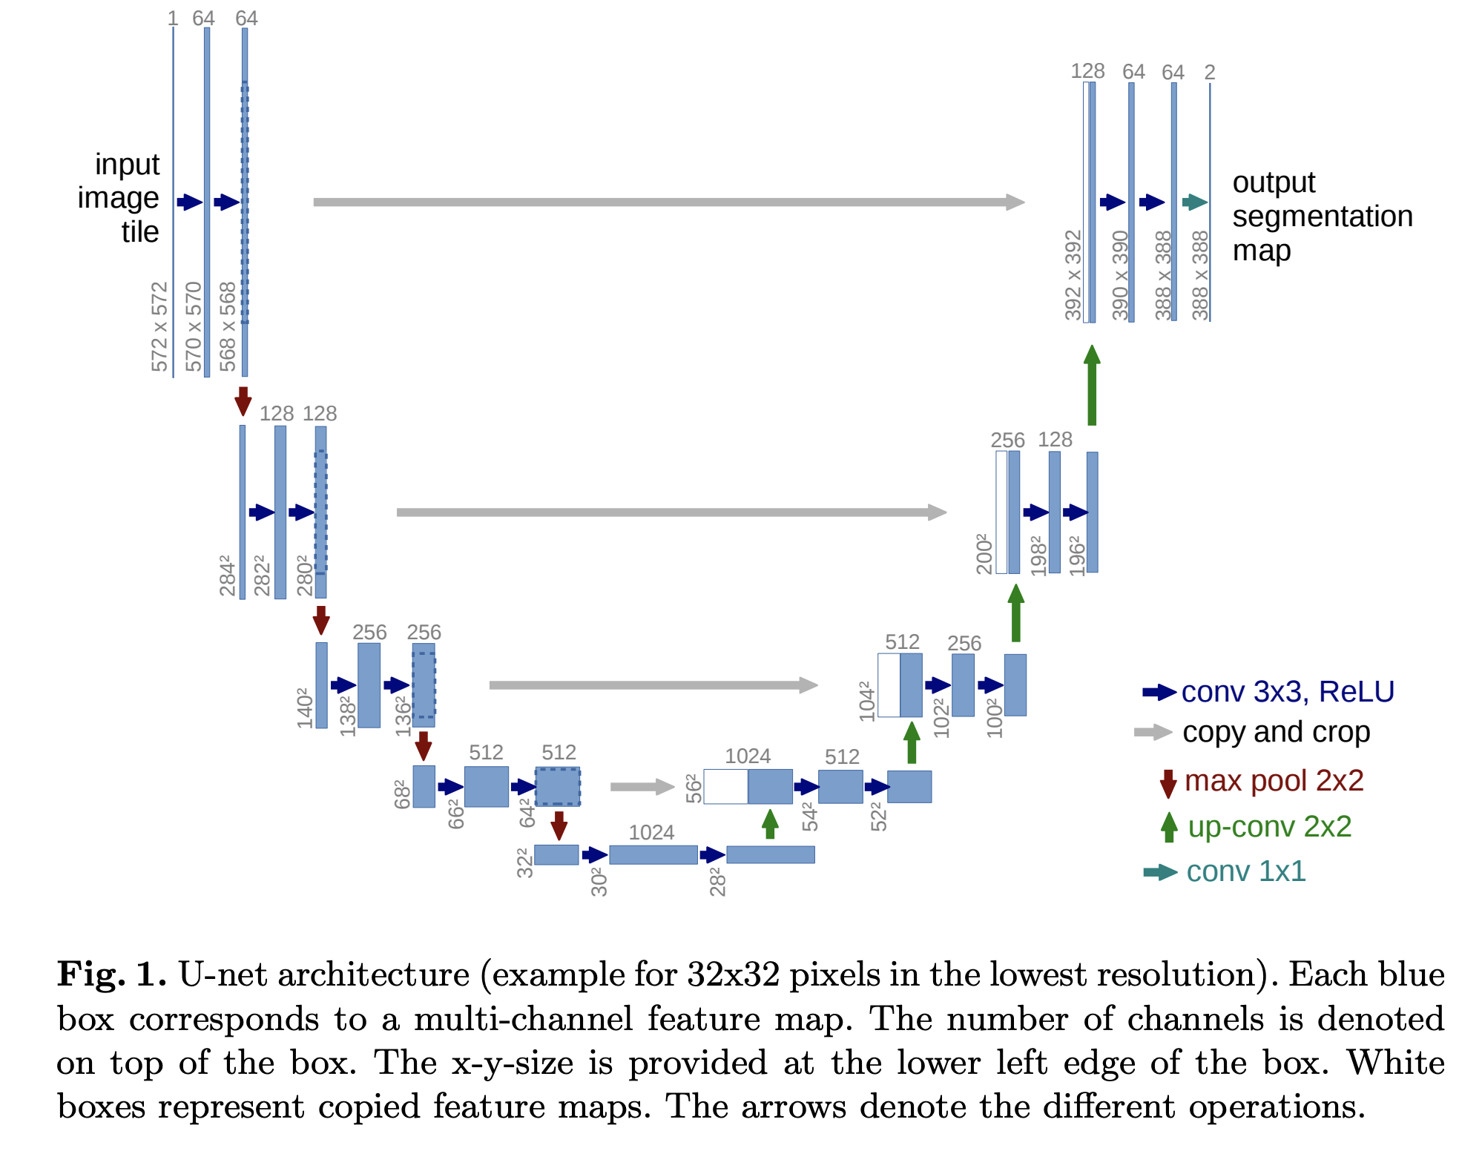
Modelling Framework
U-Net semantic segmentation model architecture
Used fastai’s Dynamic Unet model with an ImageNet-pretrained resnet 34 encoder.
Multi-combination loss function: Dice Loss & Focal Loss
Annotation includes 3 labels (footprint, boundary, and contact). Used the combination loss for its ability to fine-tune the weights for each class to account for disproportionate sampling w/ ‘contact’ class.
Ran around ~100 epochs (model performance reached a plateau)
saved best model for every 20 epochs to rerun with slightly different parameters and learning rates based on the fastai’s learner suggestion and performance metrics.
Sample illustration from:
https://arxiv.org/pdf/1505.04597.pdf

Slide 25
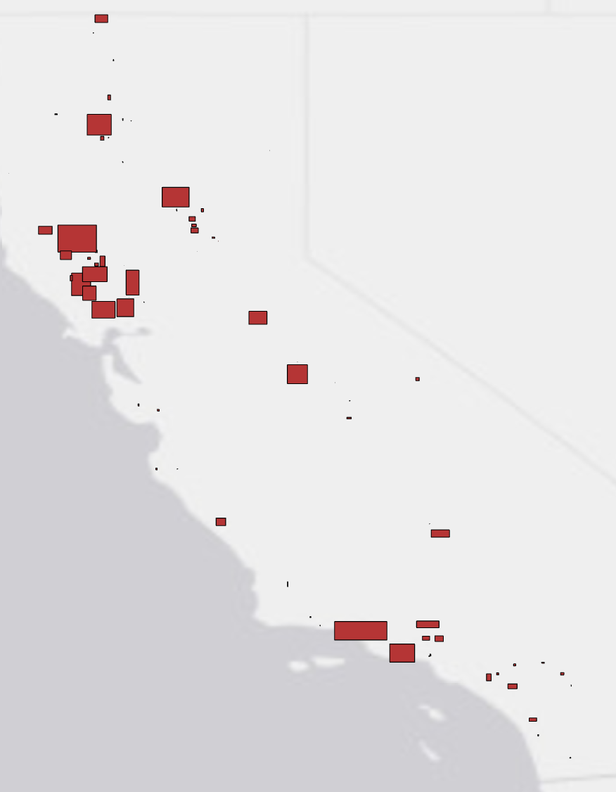
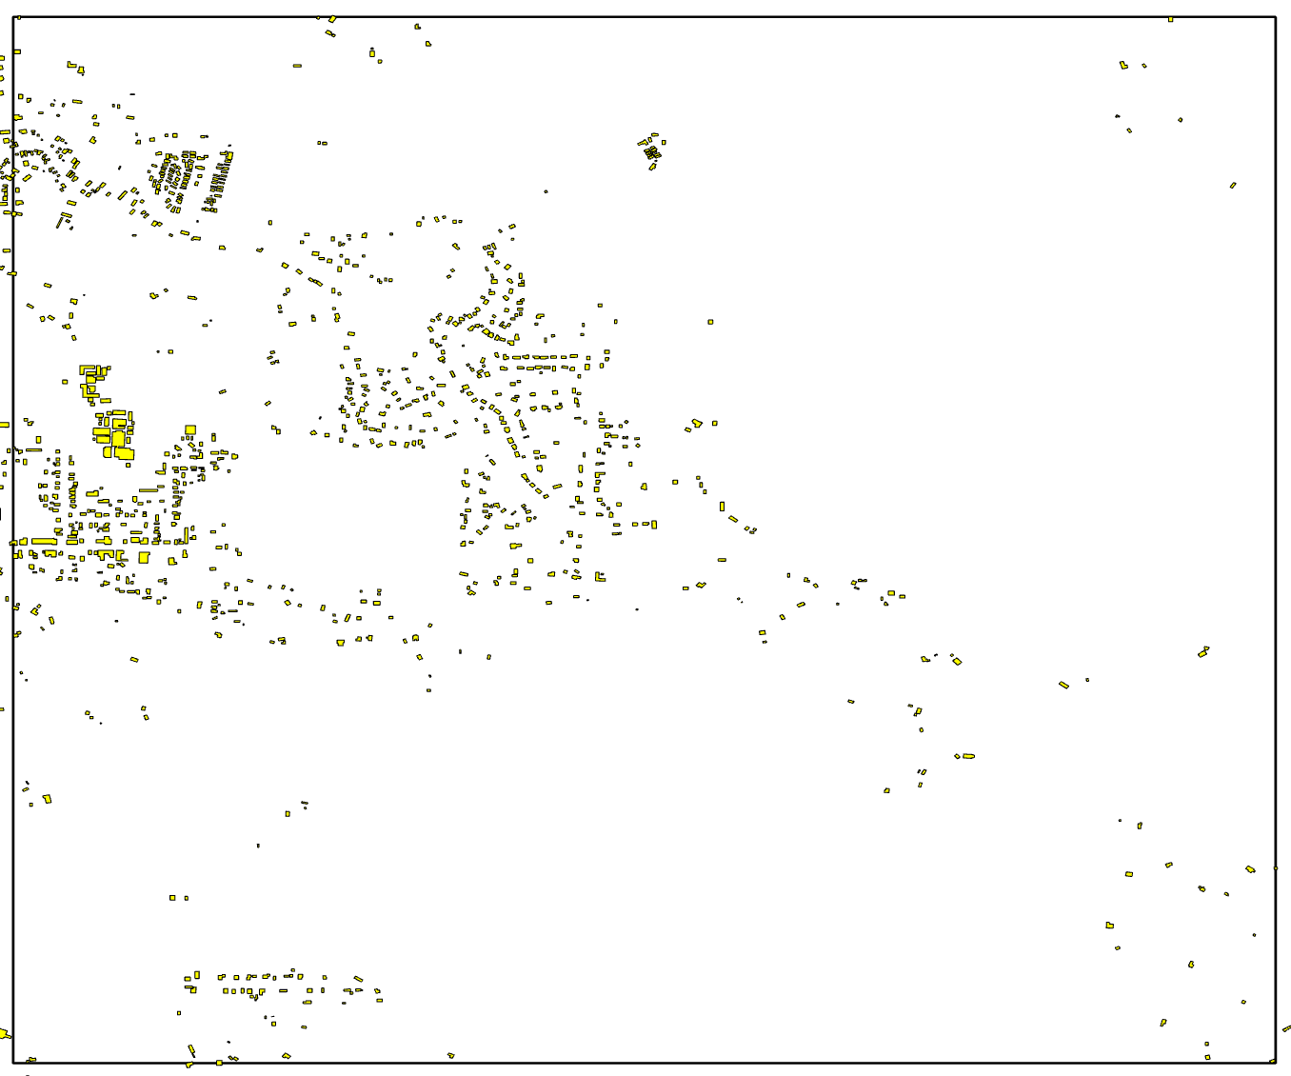
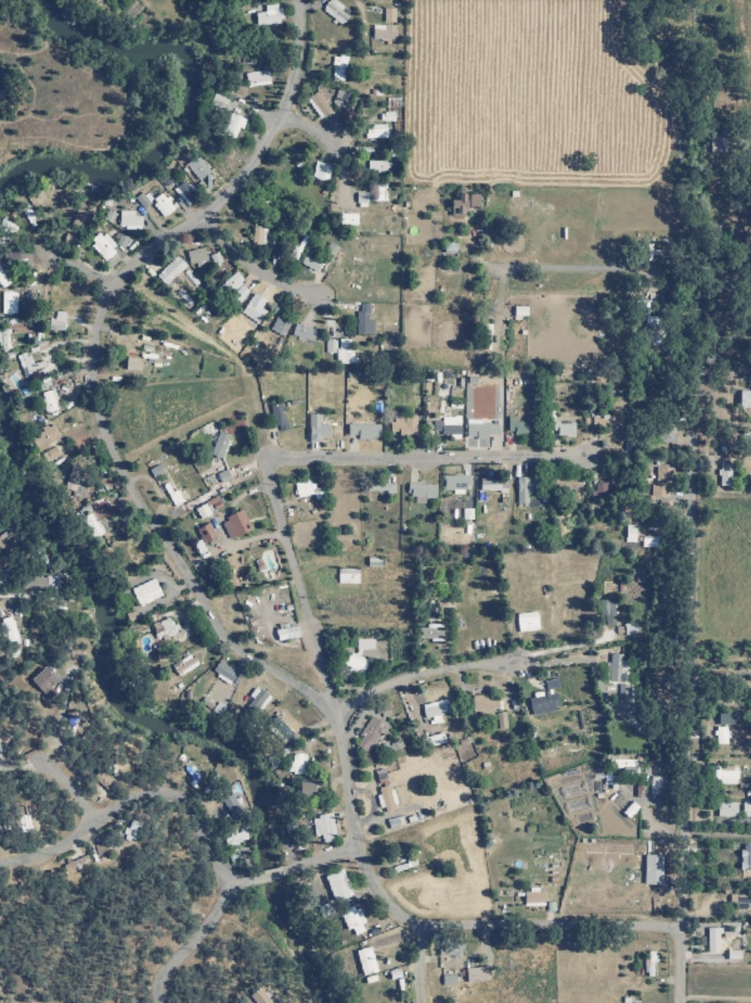
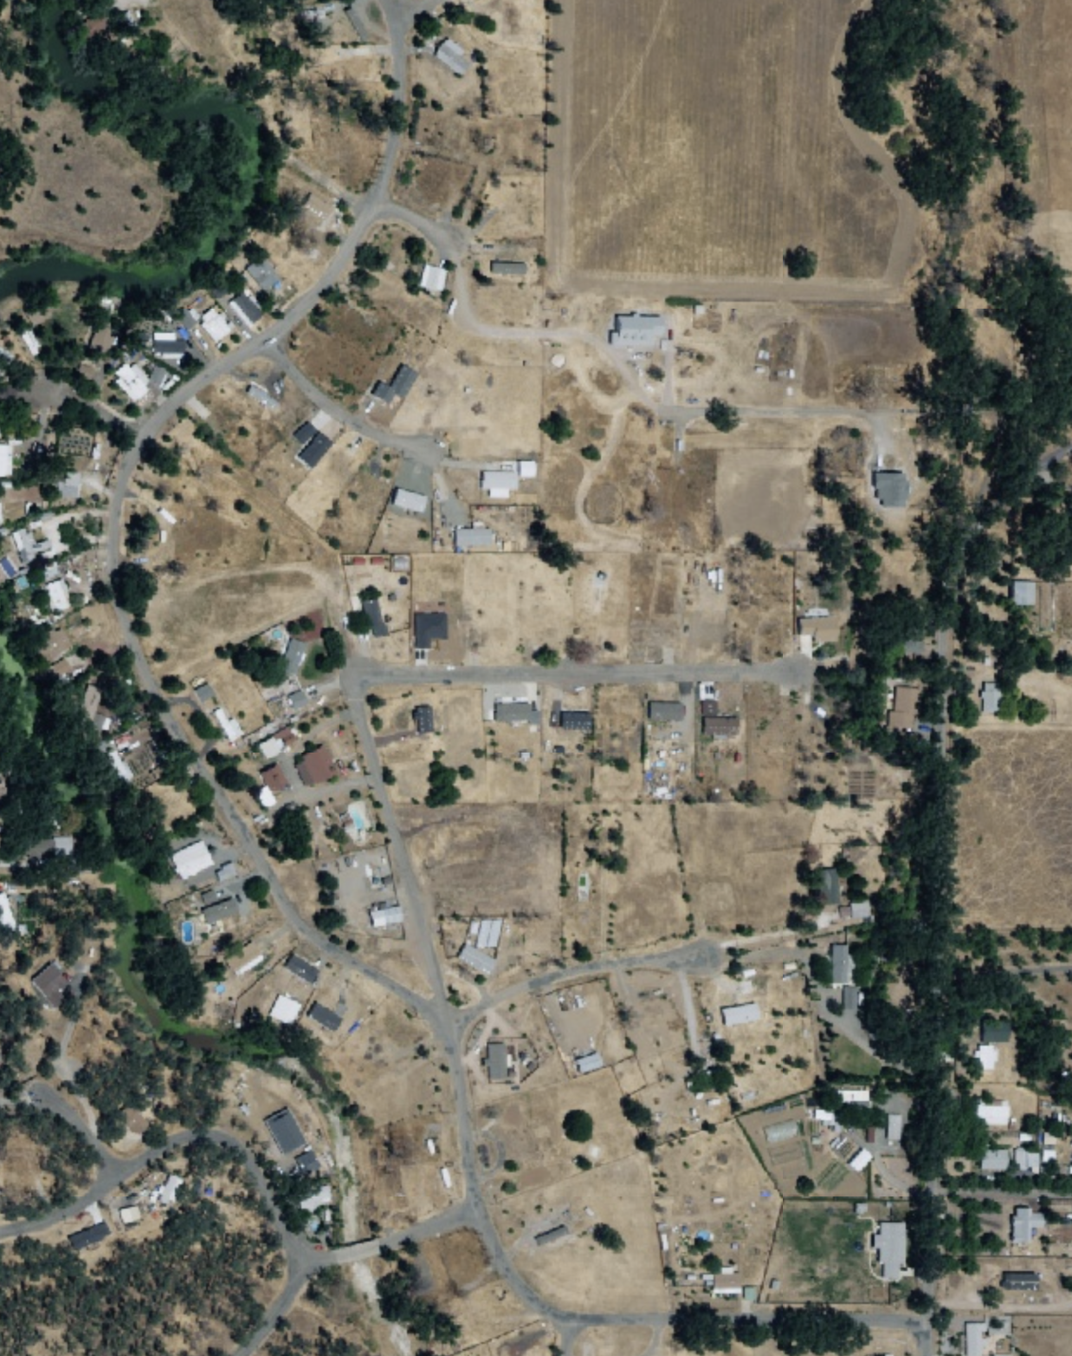
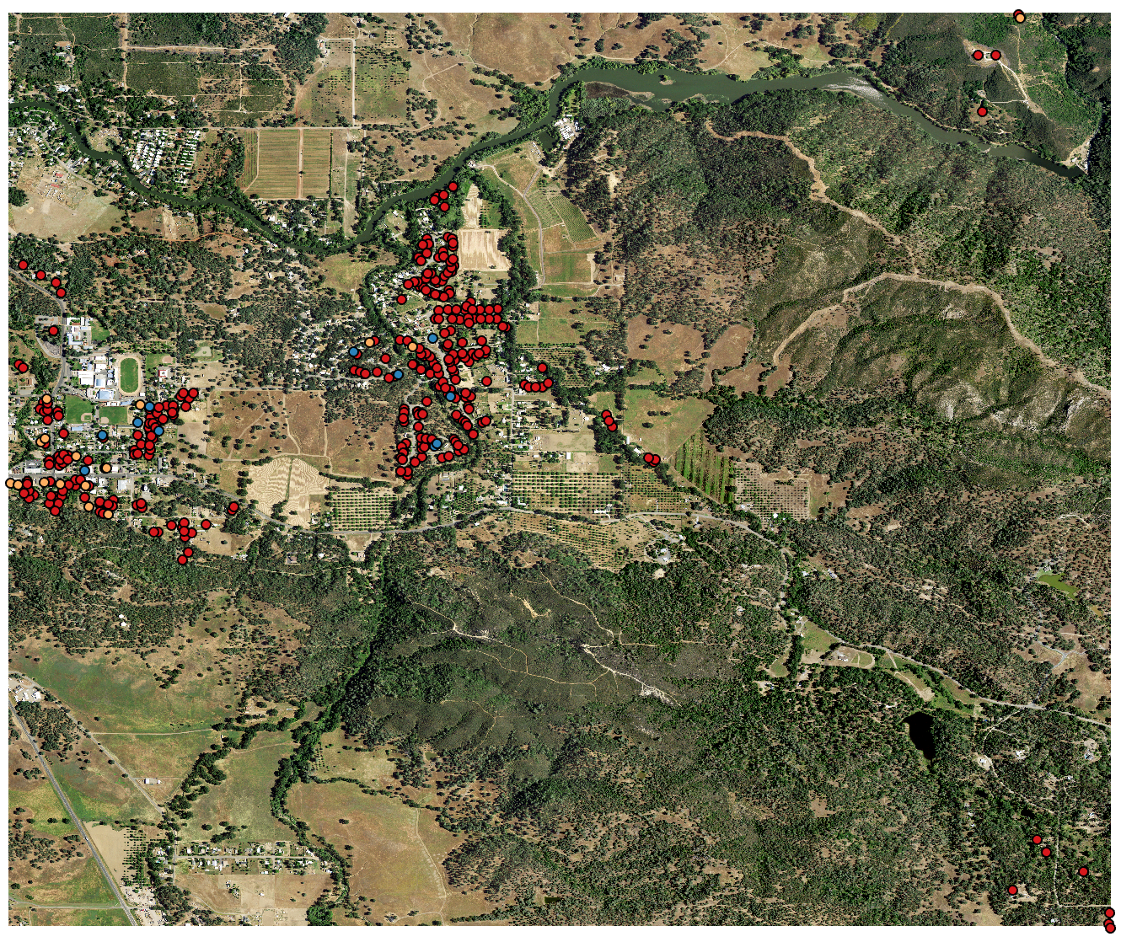
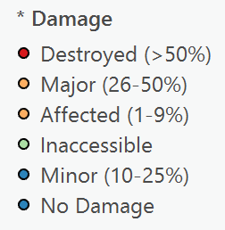
[3] NAIP Extraction
Building Footprints
Pre-fire
Post-fire
NAIP & Damage Survey

Slide 26
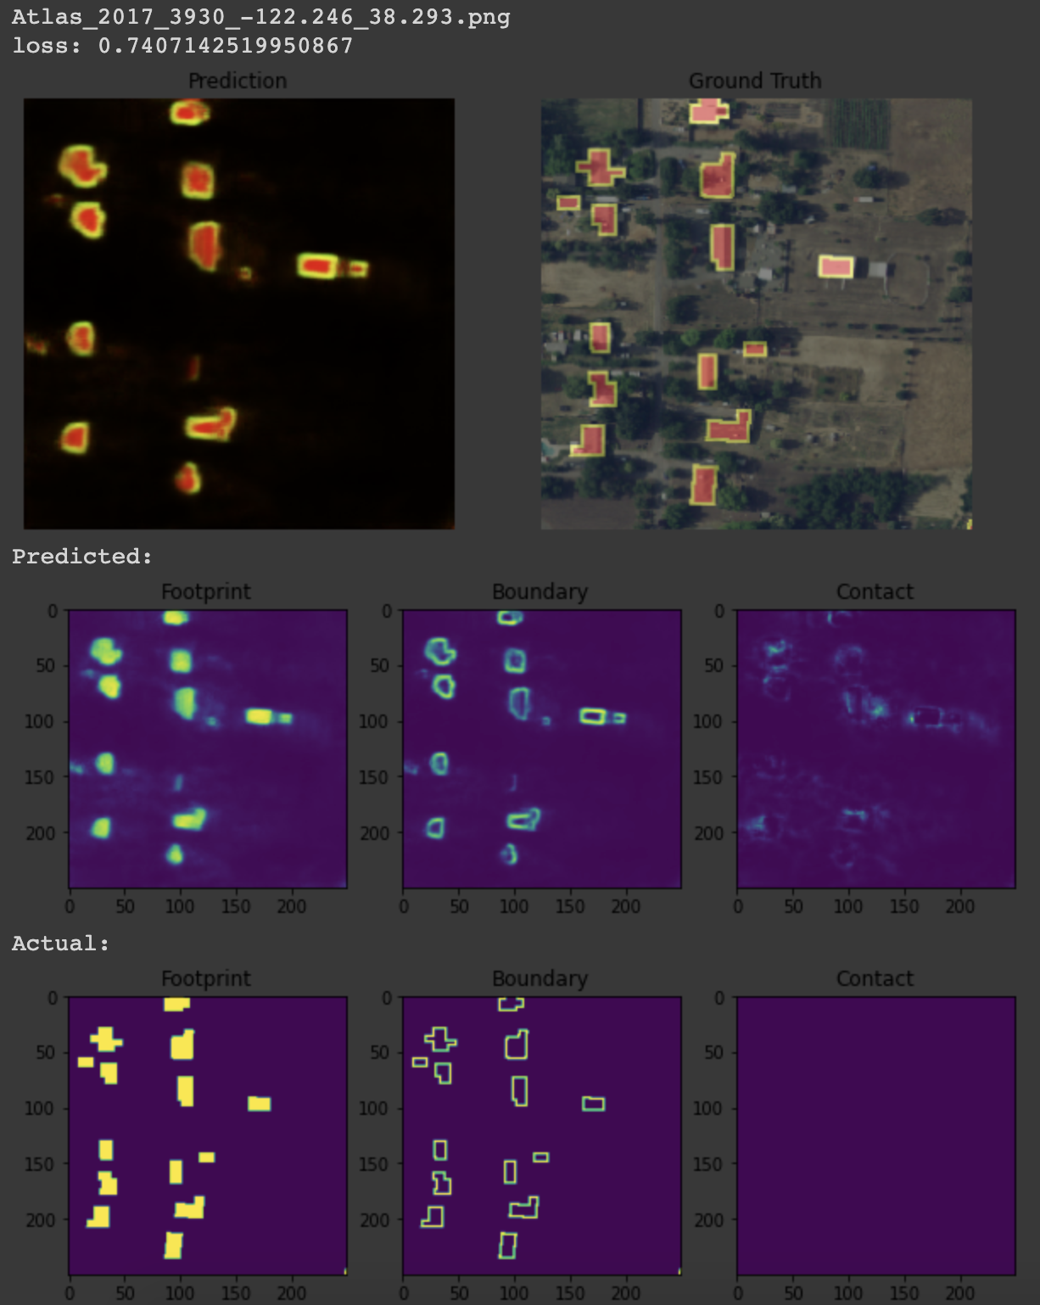
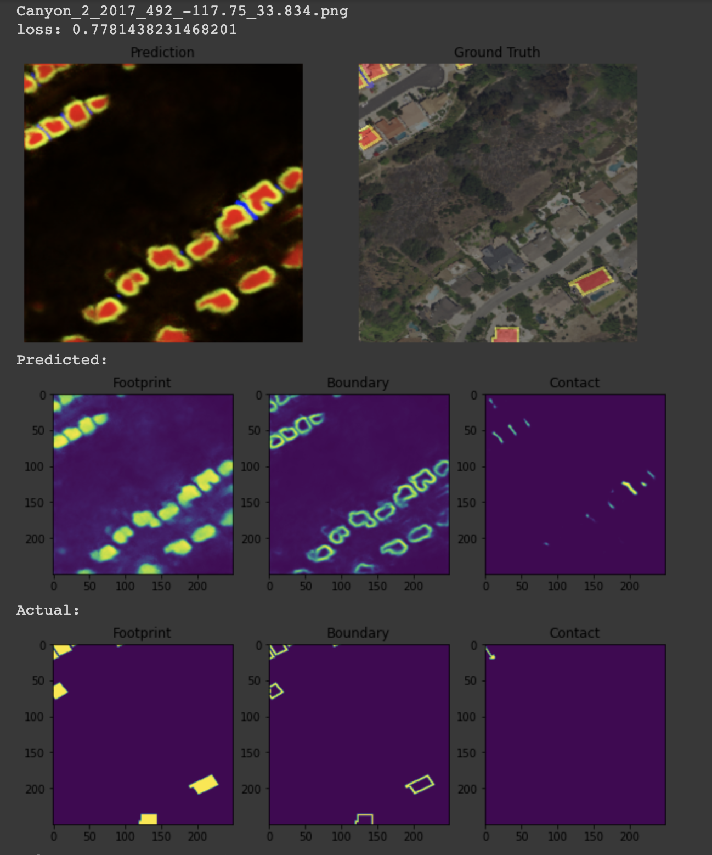
Footprint Detection
Example where groundtruth lacked building footprints in certain areas, but model was able to capture.

Slide 27
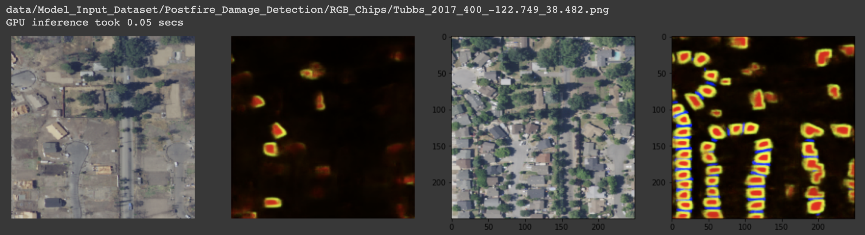
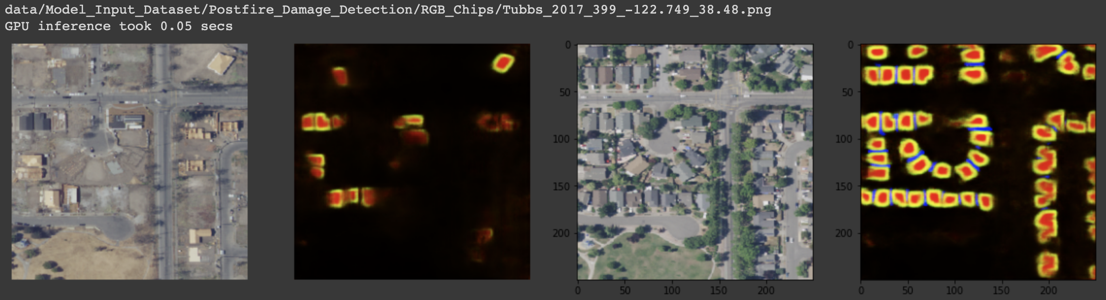
Prediction & Inference w/ Post-Fire Images
Post-fire
Pre-fire

Slide 28
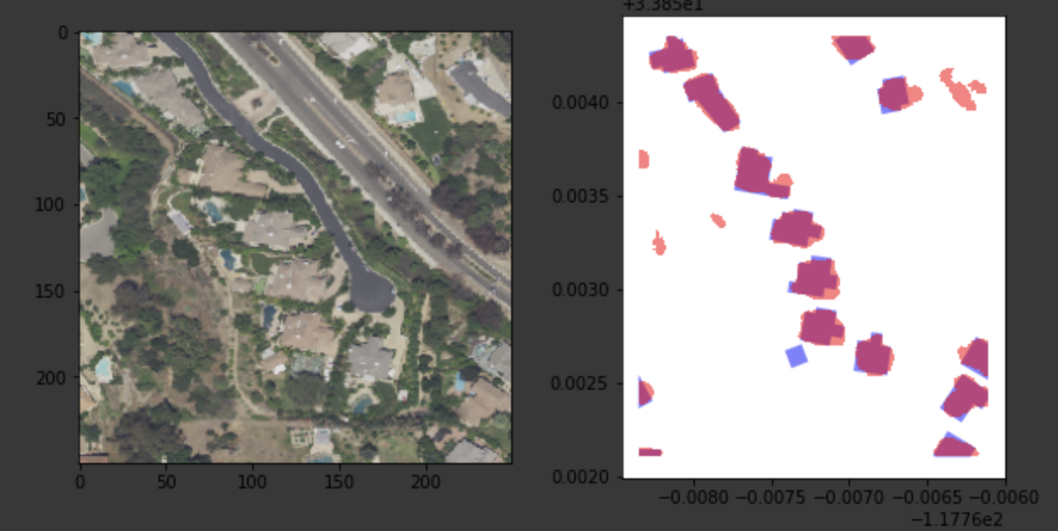
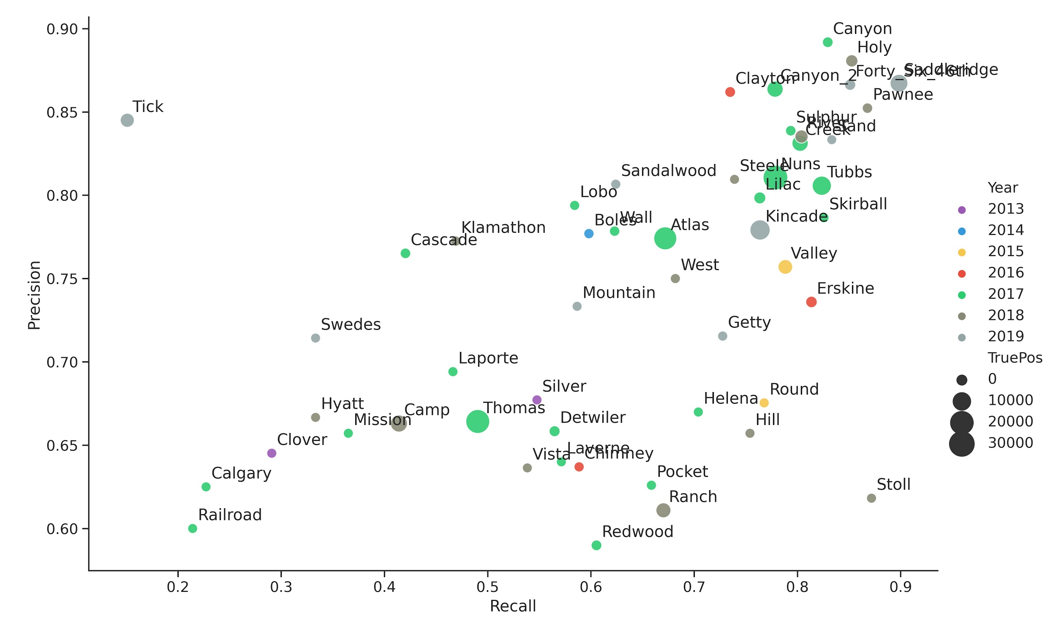
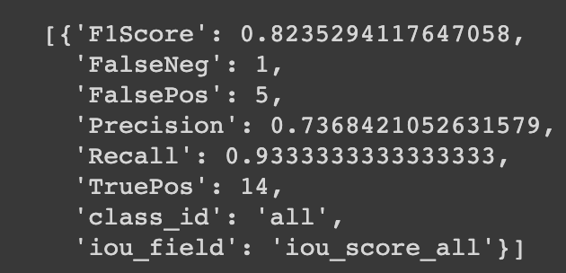
Model Evaluation by Fire

Slide 29
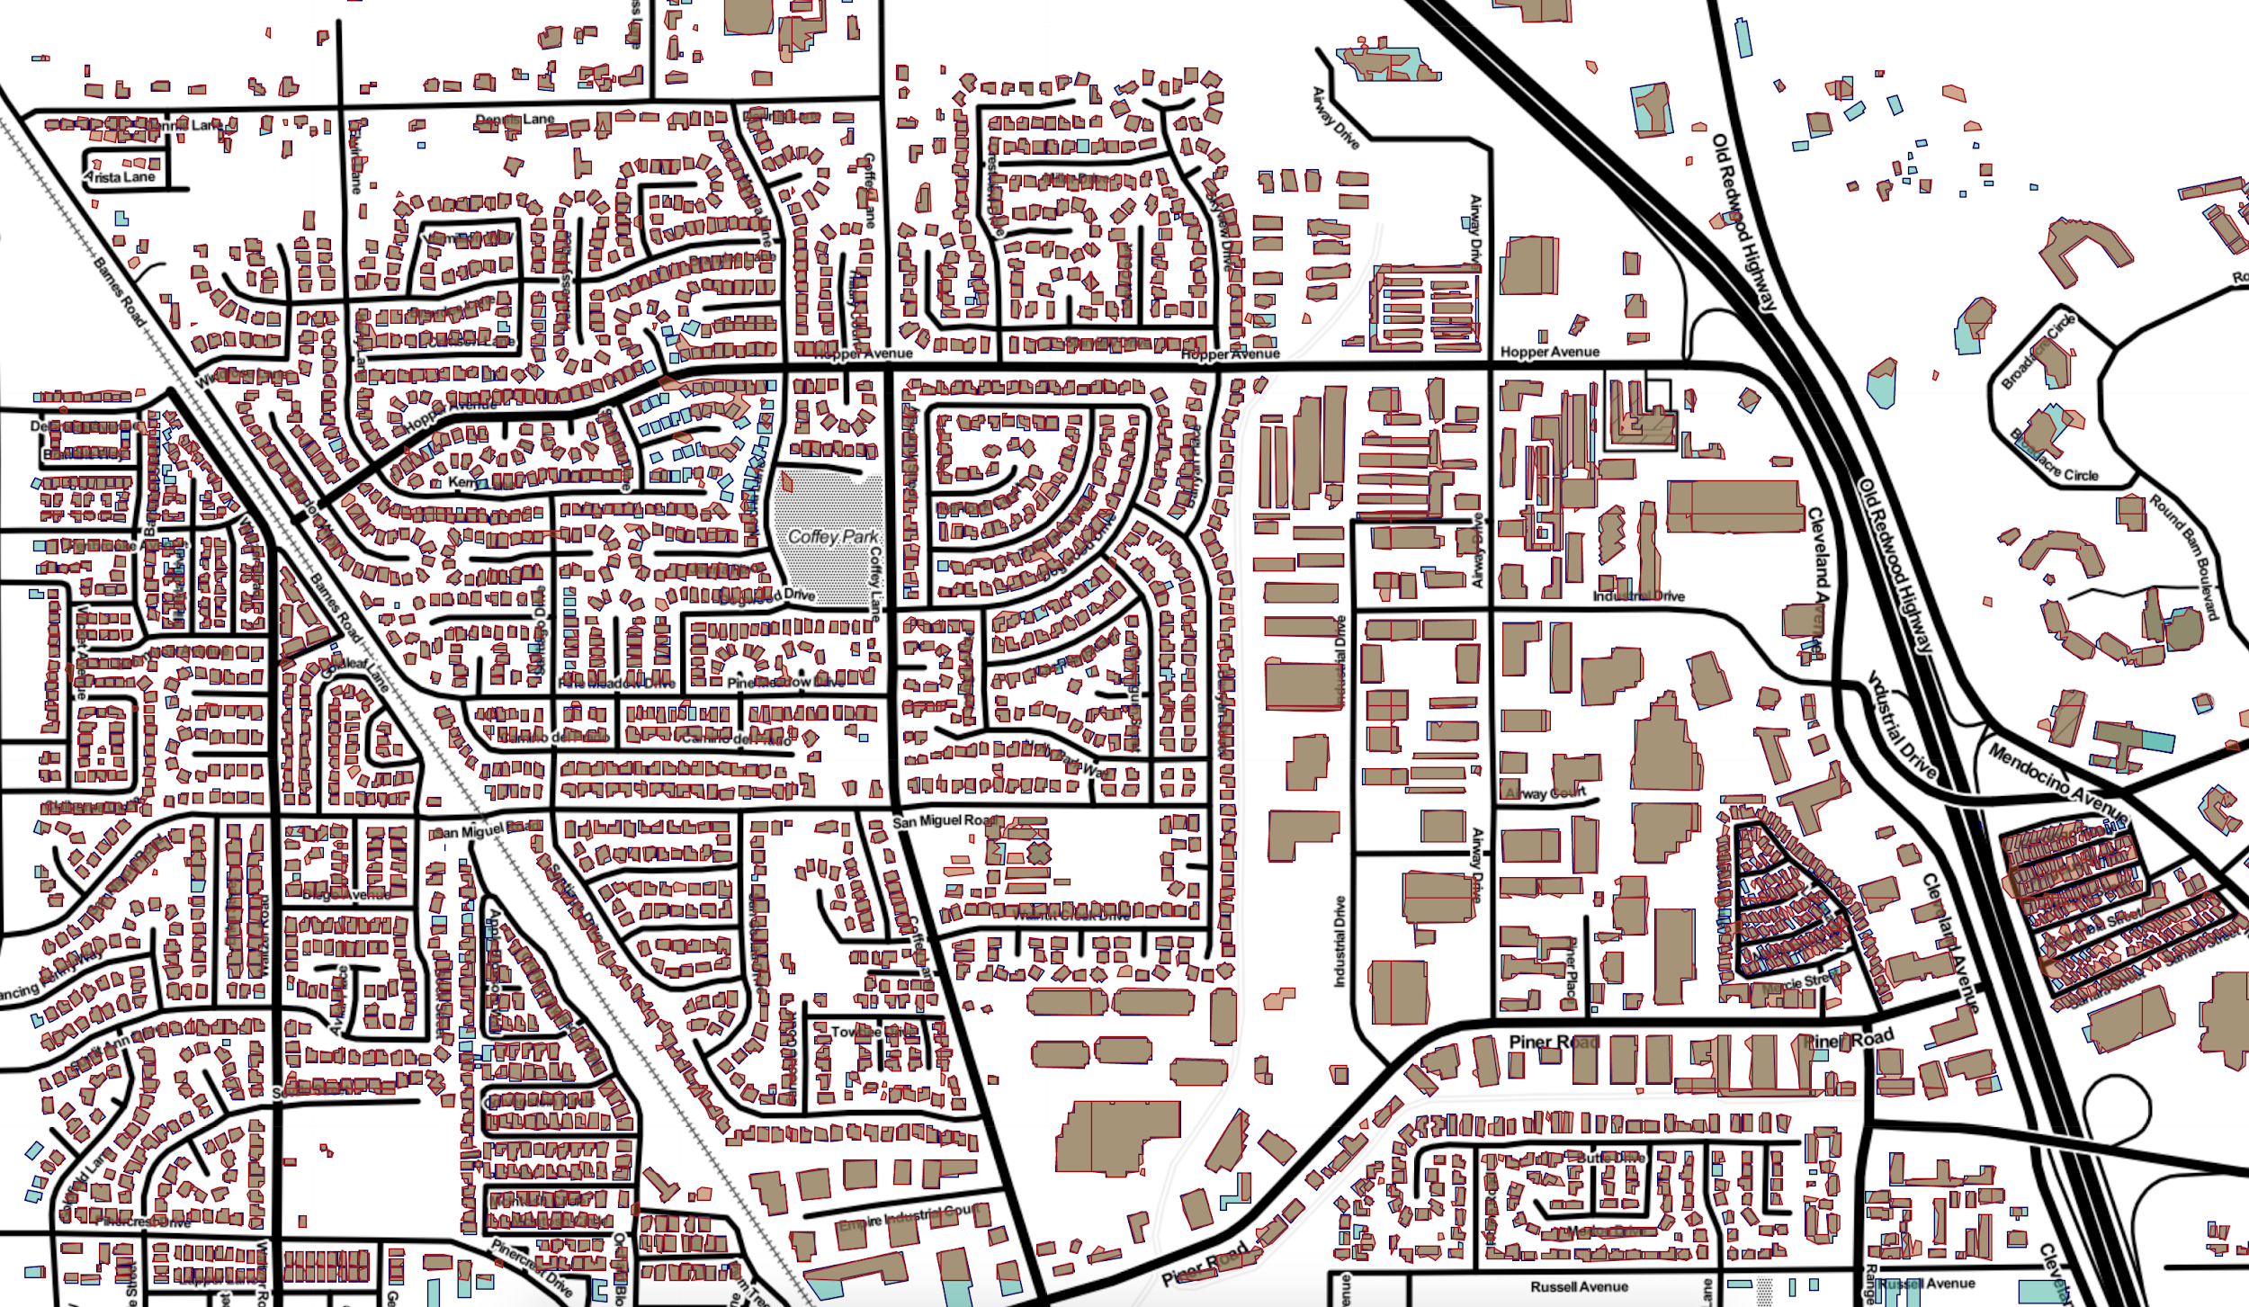
Observed vs Predicted Snapshot
True Pos
False Neg
False Pos
Interactive Map

Slide 30
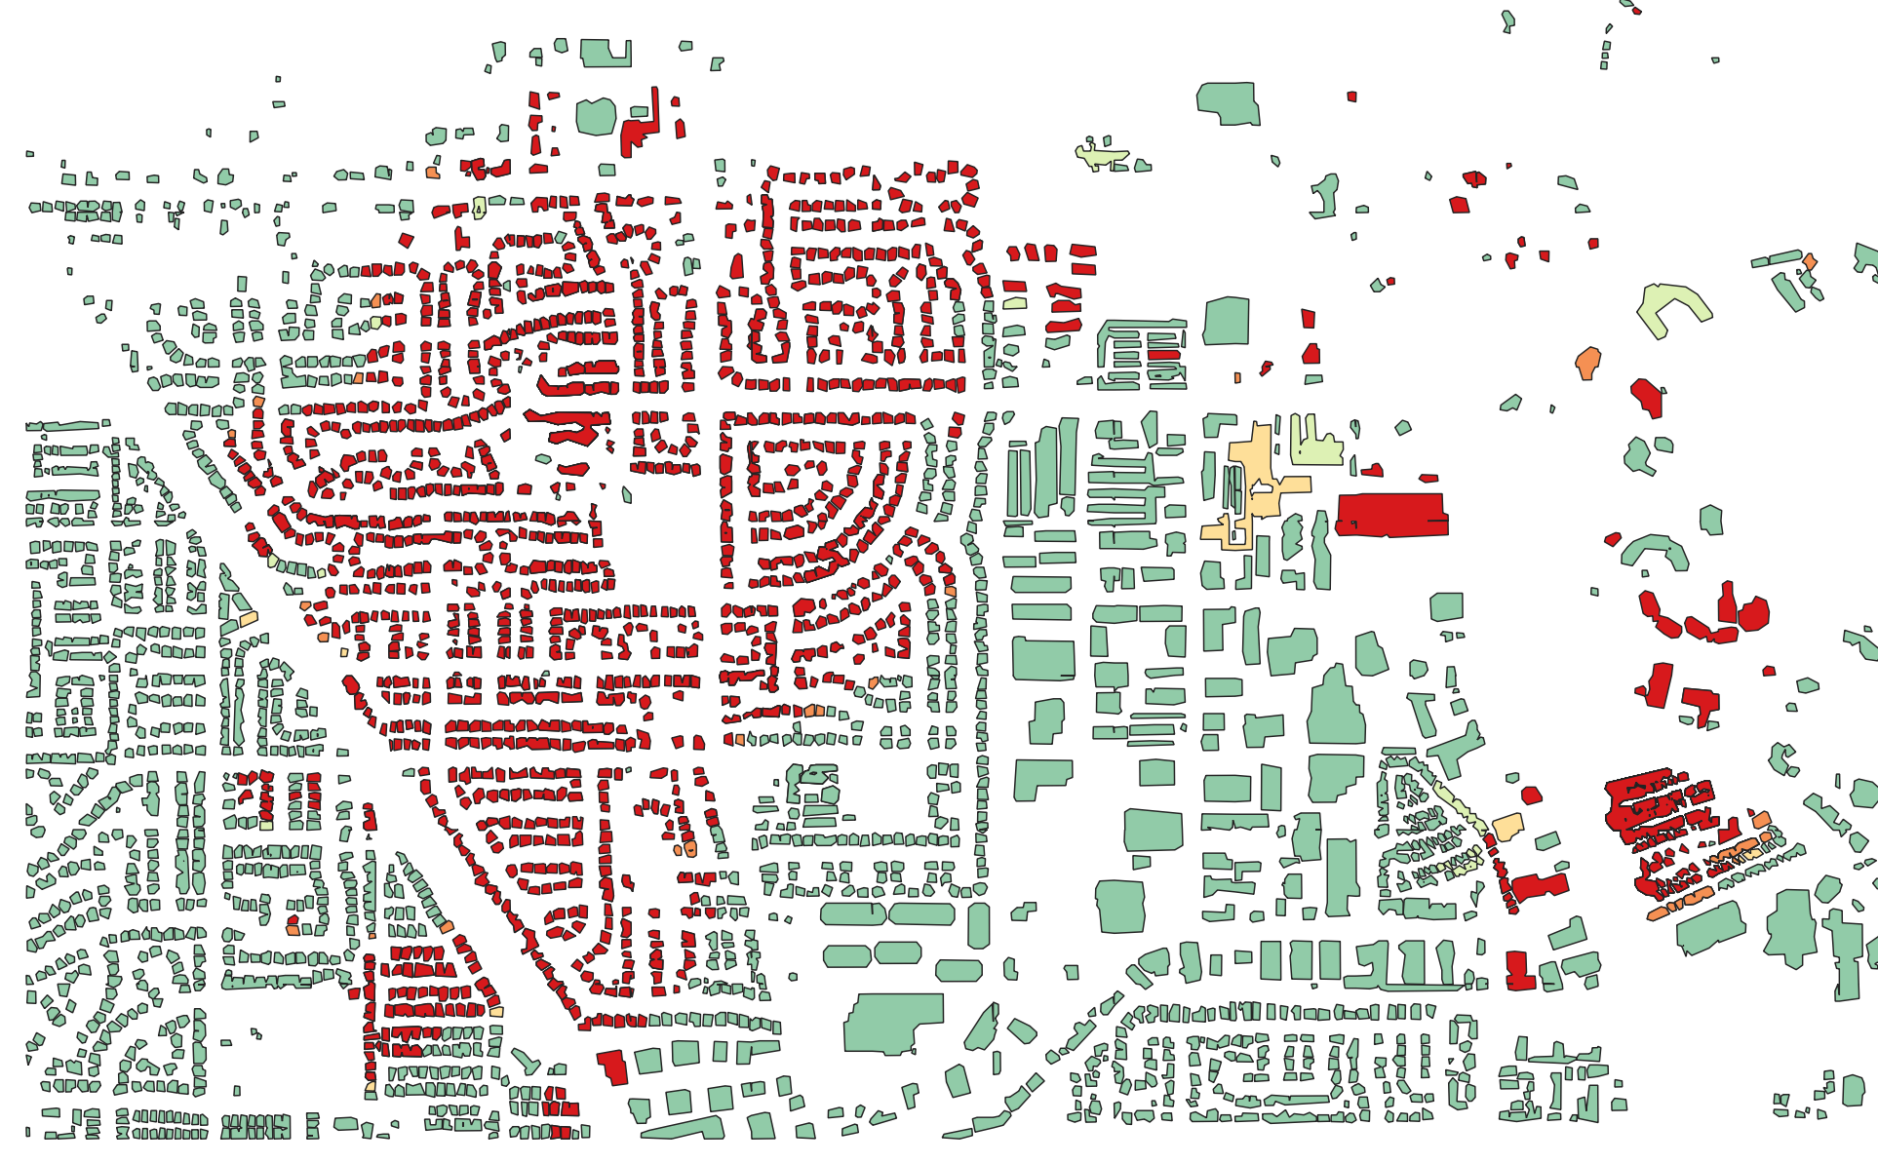
Predicted w/ Damage Attributes
Destroyed
Affected
No Damage

